Slide 1
E-Learning Design EDU624
Final Course Project

Slide 2
Online Art History II Development
Tracy Collamore
This project will be the creation of an online Art History 2 course that can be used for Post University’s online program. Art History is a popular undergraduate course at Post as it provides an interesting topic for a Humanities credit. The current shell for Art History 2 is outdated, so this is an opportunity to create a better one through the information learning in E-Learning Design for Diverse Environments. The project will be divided into 8 Units, arranged in historical, chronological order, starting with the Renaissance.
Color and font choices are based on Post University’s recent branding changes from green and white to orange and purple. Orange and purple will be used throughout the storyboard.
Font will be Century Gothic, 12pt. It is a clean and simple font, easy to read, and closely matches the Post University logo text.
Notes:
Navigation through the course will be as designed in Post’s online Blackboard shells where each Unit, Course Information, Grade Center, etc. are provided as a list on the left-hand side of the computer screen. Clicking the text will direct the student to the desired content.

Slide 3
Learning Objectives
Upon the successful completion of this course, students will be able to:
Discover how Italian and Northern European artists from the 13th-15th centuries moved away from a life focused on the divine plan of salvation and into an exploration of Humanism and nature as inspiration.
Interpret the Renaissance style of art within each work of art through formal analyses. Discover how artists focused on a high level of technical skill while creating their own unique styles.
Discover how the Reformation altered societal expectations for art, including a change in art buyers, by shifting subject matter to secular images.
Explore how Baroque art reflects societal changes, and how each geographical location created a unique interpretation of new artistic ideas.
Investigate how advances in democracy, industry, and logical thought informed artists’ desire to create images based on the rational order of thought.
Discover how painters shifted expectations of the Art Academies by using nature as inspiration, painting en plein air, and inventing color to enhance their subject matter of light.
Explore how each artistic movement pushes the modernist ideas on abstraction, which challenges the viewer to ask how we interpret art and what we should be looking for beyond the subject matter.
Discover the artistic revolutions during WWI, between the wars, and WWII as modern artists migrate to NYC, thus becoming the art epicenter of the world.
Notes:
Learning Objectives will be navigated to through Blackboard and will appear in the Course Information section. An announcement from the instructor at the start of the course will direct the students to this source.

Slide 4

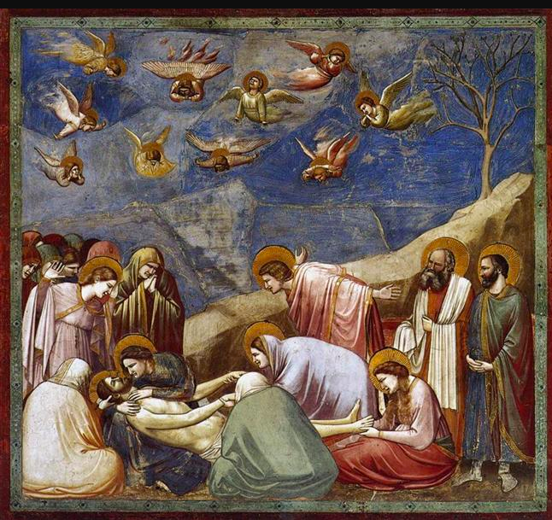

Unit 1: 13th-15th Century Italy and Northern Europe
Slide #1
Absorb Activity:
Explore Unit 1’s content in an interactive presentation, including images of major works of art and scholarly analyses of each from the Art History textbook.
http://www.coursematerials.net/Multimedia/examples/pdf_example1.pdf
Notes:
Instructional Design team members at Post would be given a PowerPoint Presentation outlining key works of art and analysis of each. Students will be able to click on an image of art which will open a window with the analysis. The provided link is an example of what the PDF will do using Unit content.

Slide 5
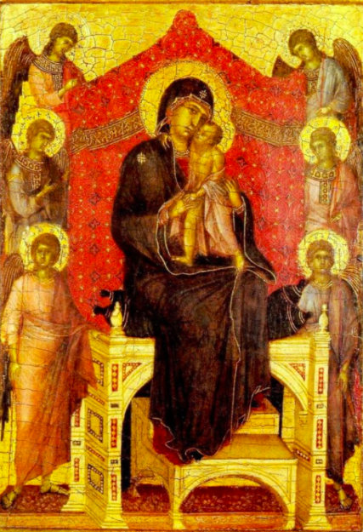
Unit 1: Do Activity #1
Slide #1.1
After reviewing the interactive content, participate in this discussion:
Artists in the Early stages of the Renaissance are starting to incorporate nature, spatial concerns, and three-dimensionality. Choose one example of art from the interactive content and formally analyze how the artist is considering these new ideas.
http://www.coursematerials.net/Multimedia/examples/pdf_example1.pdf
Notes:
Directions and navigation will be presented to enrolled students through Blackboard. A link will be provided for students to submit their paper, and feedback will be supplied directly from the instructor through the grading center. The provided link is an example of what the PDF will do using Unit content.

Slide 6
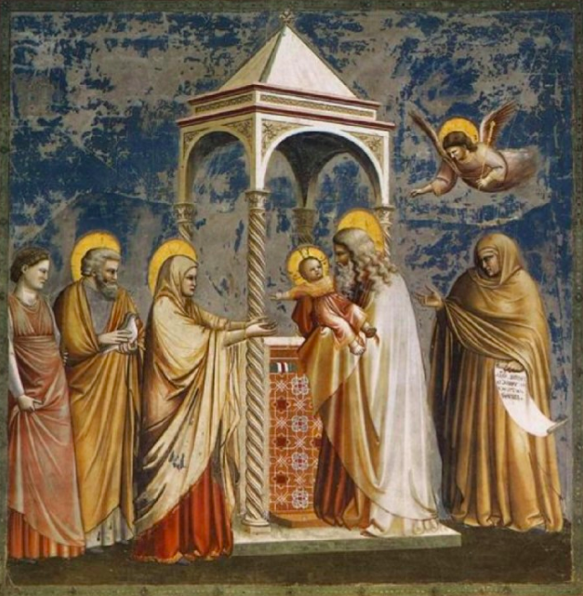
Unit 1: Do Activity #2
Slide #1.2
After reviewing the interactive content, participate in this discussion:
Consider the work of Giotto and how it is unique to the other examples of art from this time period. Compare one work of Giotto with another from the content and contrast differences through a formal analysis.
http://www.coursematerials.net/Multimedia/examples/pdf_example1.pdf
Notes:
Directions and navigation will be presented to enrolled students through Blackboard. A link will be provided for students to submit their paper, and feedback will be supplied directly from the instructor through the grading center. The provided link is an example of what the PDF will do using Unit content.

Slide 7
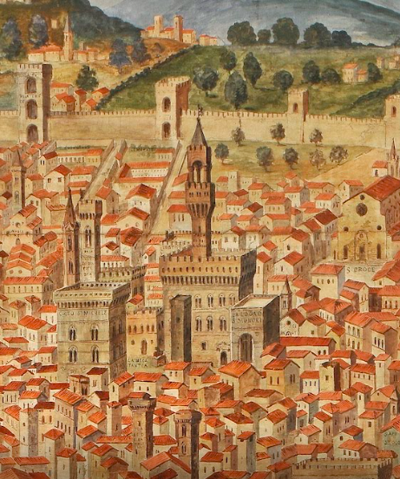
Unit 1: Connect Activity
Slide #1.3
Go on a Scavenger Hunt virtually in Florence, Italy. Search for influences in architecture from the 13th-14th centuries throughout the city. Explore the 360-degree images as well as the drawings and content: https://artsandculture.google.com/exhibit/la-veduta-della-catena-florence-and-its-monuments/JAIiVU6eaWEIJQ
Connect your search with the Unit content and write a paper revealing your discoveries.
Notes:
Link will be available under the content section of Unit 1 in Blackboard. Feedback will be provided directly from the instructor in the Grade Center.

Slide 8
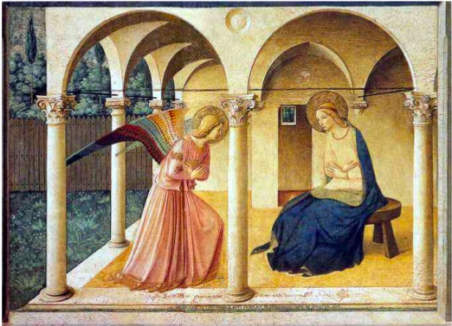
Unit 2: The Early and High Renaissance in Italy
Slide #2
Absorb Activity:
Read articles written by art historians and discover how professionals analyze various works of art from the Renaissance.
https://www.metmuseum.org/toah/hd/itar/hd_itar.htm
https://www.metmuseum.org/toah/hd/anat/hd_anat.htm
Notes:
Links to scholarly articles will be delivered as a text-click navigation in Blackboard.

Slide 9
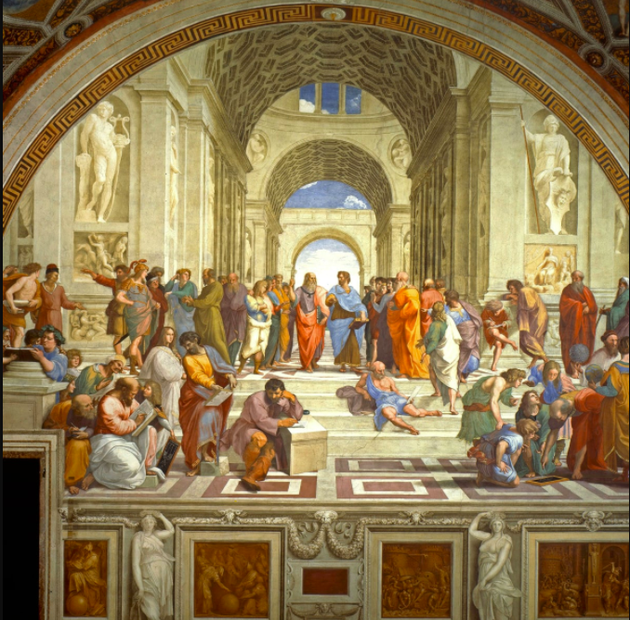
Unit 2: Do Activity #1
Slide #2.1
After reading the provided articles, complete the following activity:
Using the interactive project provided, play a matching game as many times as you need to earn an A score. Match artists with their work as well as terms with their definitions.
https://quizlet.com/119319665/unit-1-2-test-prep-proto-high-renaissance-flash-cards/
Notes:
Quizlet link will be available to students in the Blackboard content section. Students will be given written instructions on how to find the required game to complete. Students will be directed to take a screen-shot of their final score to submit to the instructor.

Slide 10
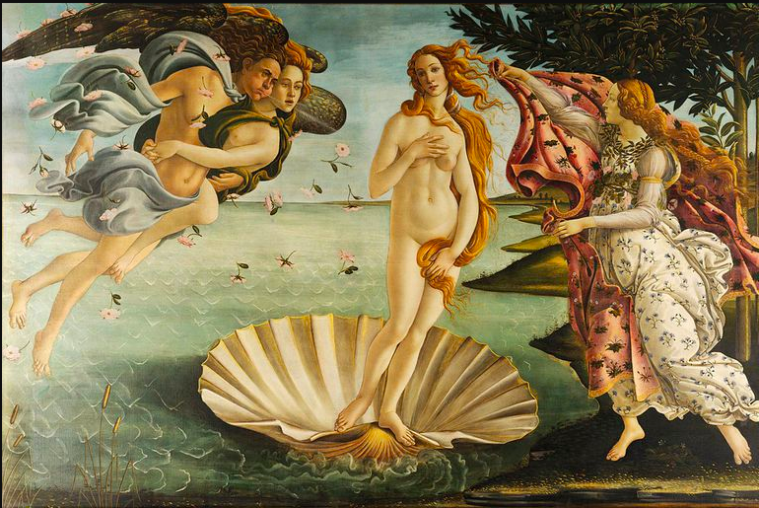
Unit 2: Do Activity #2
Slide #2.2
After reading the provided articles, complete the following activity:
Develop a Prezi presentation analyzing 4 pieces of art or architecture: two from Unit 1 and two from Unit 2. Share your presentation in the provided discussion thread and discuss your project and those of your peers.
https://prezi.com/
Notes:
Students will be provided instructions for the Prezi presentation and the Discussion Board. Links will be provided in Blackboard to submit their assignments. Instructions for using Prezi will be provided within the assignment instructions. A link to Prezi will be provided in Unit resources.

Slide 11
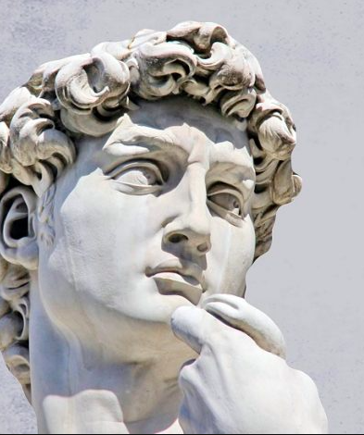
Unit 2: Connect Activity
Slide #2.3
Research the life of Michelangelo and his greatest artistic achievements in both art and architecture. See how his work influenced many more who followed.
Write about your research and include at least two artists who were influenced by him, and how.
https://post.blackboard.com/webapps/portal/execute/tabs/tabAction?tab_tab_group_id=_646_1
Notes:
Directions and navigation will be presented to enrolled students through Blackboard. A link will be provided for students to submit their paper, and feedback will be supplied directly from the instructor through the grading center.

Slide 12
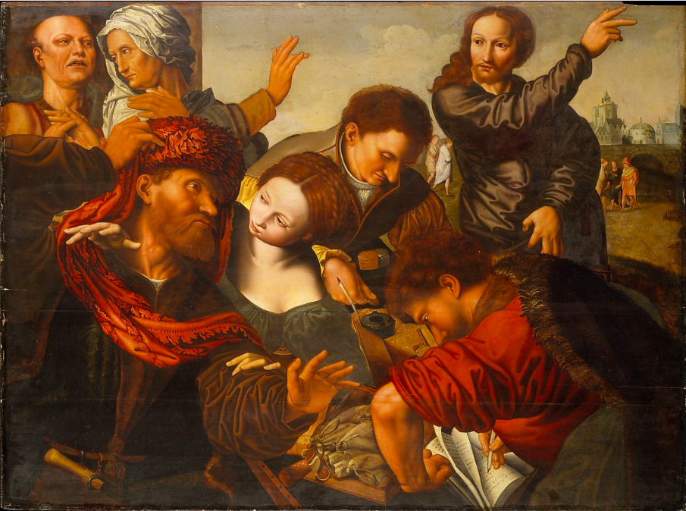
Unit 3: The Late Renaissance and Reformation
Slide #3
Absorb Activity:
Watch a video summarizing how societal trends affected artwork in each category of the historical periods.
https://www.youtube.com/watch?v=tecocKSclwc&vl=en
Notes:
The video will be presented as a Mash-Up where students can click to open a small window or click to go directly to the YouTube site.

Slide 13
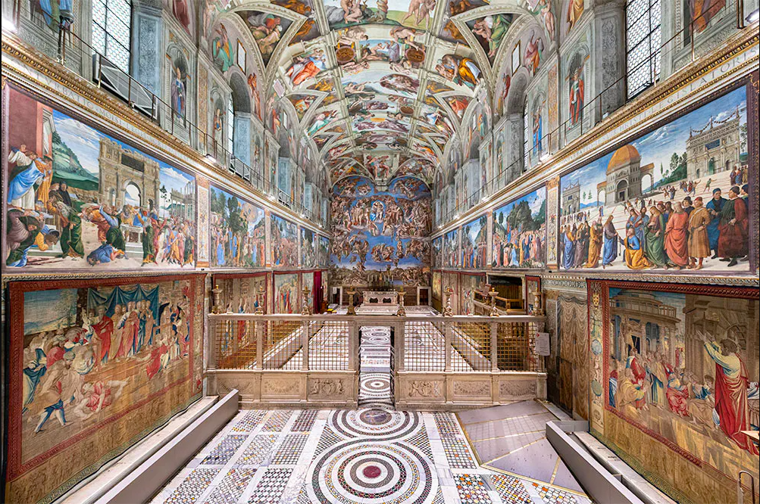
Unit 3: Do Activity #1
Slide #3.1
After watching the video, complete the following activity:
Virtually discover the Sistine Chapel in Rome through Google Arts and Culture. Explore the site thoroughly, then discuss your experiences in a discussion board.
https://artsandculture.google.com/theme/the-unlikely-figure-we-have-to-thank-for-the-renaissance%E2%80%99s-greatest-masterpieces/LALSBZb7R5YTKA
Notes:
Link will be available under the content section of Unit 3 in Blackboard. Feedback will be provided directly from peers in the discussion board and from the instructor in the Grade Center.

Slide 14
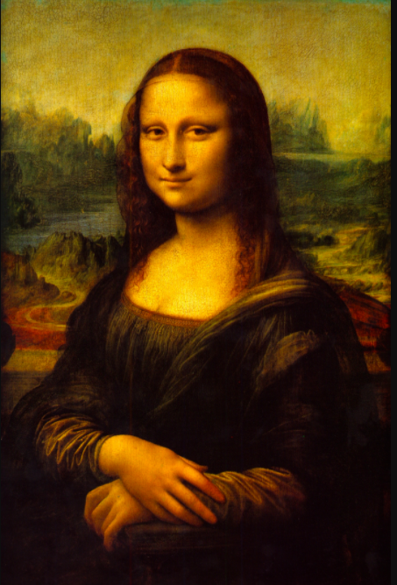
Unit 3: Do Activity #2
Slide #3.2
After watching the video, complete the following activity:
Write a reflective paper on the progression of art and architecture during the Reformation, focusing on analyzing the movements and artists in your own words. Share your drafts to a class website and review others’ work by adding feedback. Revise your draft with feedback given to you.
https://post.blackboard.com/webapps/portal/execute/tabs/tabAction?tab_tab_group_id=_646_1
Notes:
Directions and navigation will be presented to enrolled students through Blackboard. A link will be provided for students to submit their paper on a class website, and feedback will be supplied directly from the instructor through the grading center.

Slide 15
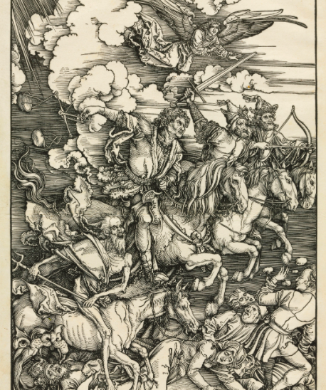
Unit 3: Connect Activity
Slide #3.3
After reviewing the Unit’s content, engage in a virtual group critique with your peers and instructor through Zoom.
To prepare, choose one artist from Unit 3, search for more information, and present your findings in the virtual meeting. Peers will provide critiques on your work and you will critique your peers.
https://zoom.us/
Notes:
Links to Zoom will be available in the course content with instructions to sign up. A link for the scheduled synchronous meeting will be provided by the instructor in the beginning of Unit 3 through an announcement.

Slide 16
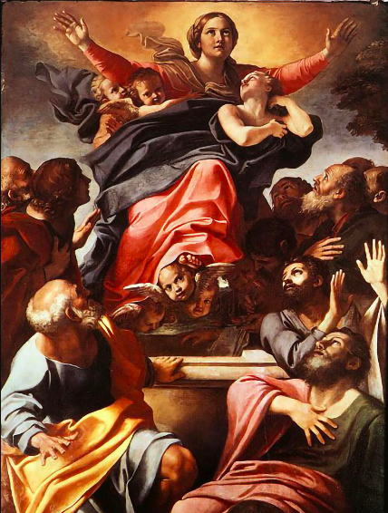
Unit 4: The Baroque in Western Europe
Slide #4
Absorb Activity
Discover the societal changes that continue to affect the Baroque movement throughout Western Europe through an interactive presentation.
http://www.coursematerials.net/Multimedia/examples/pdf_example1.pdf
Notes:
Instructional Design team members at Post would be given a PowerPoint Presentation outlining key works of art and analysis of each. Students will be able to click on an image of art which will open a window with the analysis. The provided link is an example of what the PDF will do using Unit content.

Slide 17
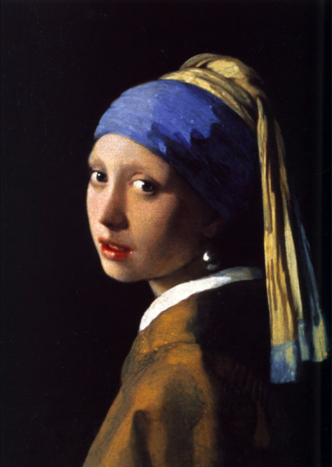
Unit 4: Do Activity #1
Slide #4.1
After reviewing the interactive content, complete the following activity:
Using the interactive project from Quizlet provided, play the Asteroids simulation matching artists to their work. Play as many times as you need to earn an A score. Discuss your experience in a discussion board.
https://quizlet.com/124288830/unit-3-4-test-prep-reformation-and-baroque-flash-cards/
Notes:
Quizlet link will be available to students in the Blackboard content section. Students will be given written instructions on how to find the required game to complete. Students will be directed to take a screen-shot of their final score to submit to the instructor.

Slide 18
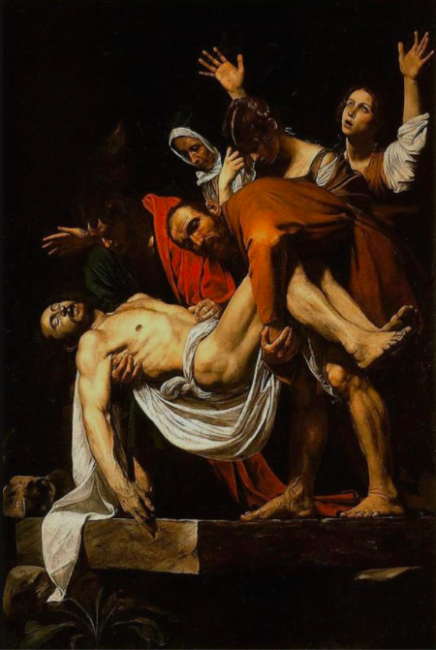
Unit 4: Do Activity #2
Slide #4.2
After reviewing the interactive content, complete the following activity:
Develop a Prezi presentation analyzing 4 pieces of art or architecture: two from Unit 3 and two from Unit 4. Share your presentation in the provided discussion thread and discuss your project and those of your peers.
https://prezi.com/
Notes:
Students will be provided instructions for the Prezi presentation and the Discussion Board. Links will be provided in Blackboard to submit their assignments. Instructions for using Prezi will be provided within the assignment instructions. A link to Prezi will be provided in Unit resources.

Slide 19
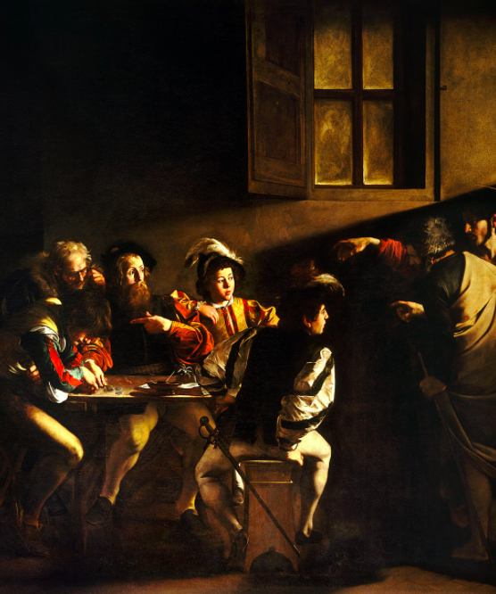
Unit 4: Connect Activity
Slide #4.3
Using the following weblink, (https://artsandculture.google.com/story/the-night-watch/dALSivMco4xIJA) go on a visual scavenger hunt in Rembrandt’s paintings.
Discover the intricate details and painting process not otherwise seen in a photograph. Share your discoveries in a reflective paper.
https://post.blackboard.com/webapps/portal/execute/tabs/tabAction?tab_tab_group_id=_646_1
Notes:
Directions and navigation will be presented to enrolled students through Blackboard. A link will be provided for students to submit their paper, and feedback will be supplied directly from the instructor through the grading center.

Slide 20
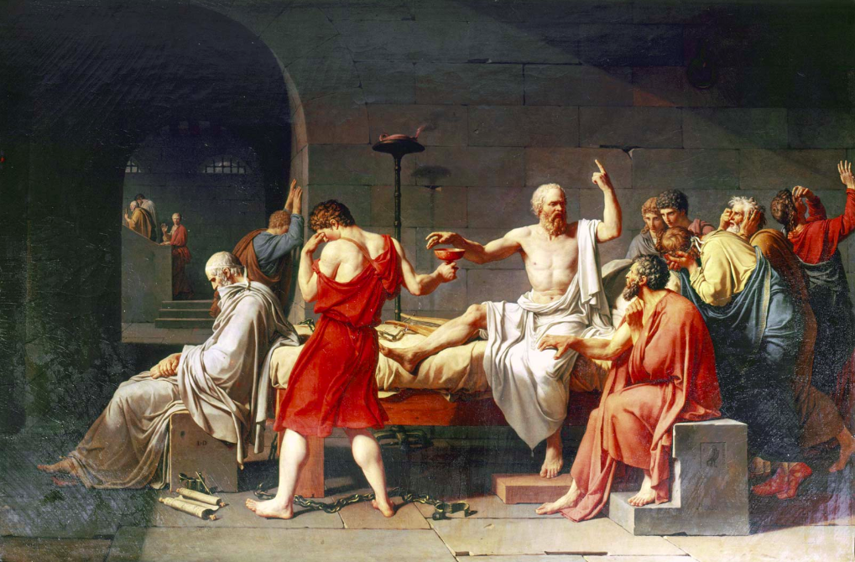
Unit 5: The Age of Enlightenment and Romanticism
Slide #5
Absorb Activity:
Read the chapters from your textbook describing the changes in art during the Age of Enlightenment and Romanticism.
https://post.edu/student-services/library/virtual-library/
Notes:
Links will be provided to a University approved art history textbook through their online library. Students will be directed to each required chapter through text clicks.

Slide 21
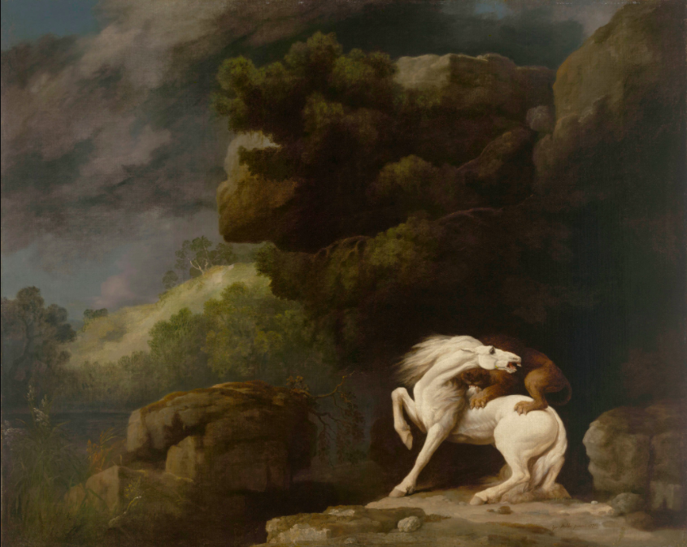
Unit 5: Do Activity #1
Slide #5.1
After reviewing the readings, participate in this discussion:
The Age of Enlightenment sees a large shift in artistic creations and purpose. Consider Neo-Classicism and compare/contrast with each other in a discussion board. Reply to your peers with your thoughts.
https://post.blackboard.com/webapps/portal/execute/tabs/tabAction?tab_tab_group_id=_646_1
Notes:
Link will be available under the content section of Unit 5 in Blackboard. Feedback will be provided directly from peers in the discussion board and from the instructor in the Grade Center.

Slide 22
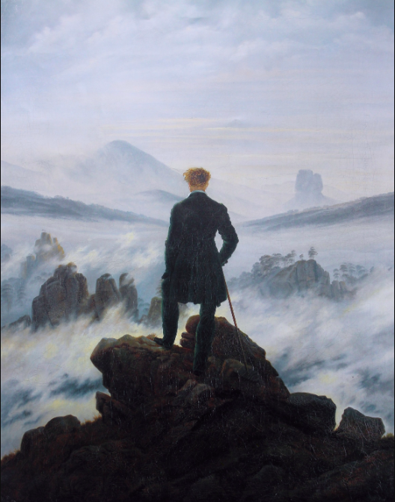
Unit 5: Do Activity #2
Slide #5.2
After reading the textbook, complete the following activity:
Write a reflective paper on the progression of art from the Renaissance to the Age of Enlightenment, focusing on analyzing the movements and artists in your own words. Share your draft on the class website for feedback.
https://post.blackboard.com/webapps/portal/execute/tabs/tabAction?tab_tab_group_id=_646_1
Notes:
Directions and navigation will be presented to enrolled students through Blackboard. A link will be provided for students to submit their paper to the class website, and feedback will be supplied directly from peers and the instructor through the grading center.

Slide 23
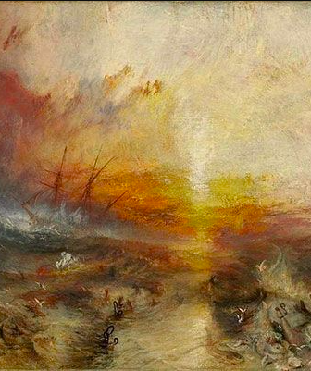
Unit 5: Connect Activity
Slide #5.3
Research the movement of Romanticism in art and music. Discover the similarities and differences of artists from all media using the influences of the principles of Romanticism. Share your discoveries in a paper.
https://post.blackboard.com/webapps/portal/execute/tabs/tabAction?tab_tab_group_id=_646_1
Notes:
Directions and navigation will be presented to enrolled students through Blackboard. A link will be provided for students to submit their paper, and feedback will be supplied directly from the instructor through the grading center.

Slide 24
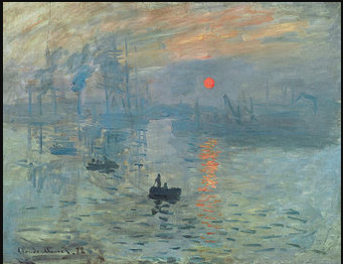
Unit 6: Realism, Impressionism, and Post-Impressionism
Slide #6
Absorb Activity:
Explore a PowerPoint presentation highlighting the key works of art from the Impressionist movement, discovering how each individual artist created a unique style based on similar ideas.
http://www.coursematerials.net/Multimedia/examples/pdf_example1.pdf
Notes:
Instructional Design team members at Post would be given a PowerPoint Presentation outlining key works of art and analysis of each. Students will be able to click on an image of art which will open a window with the analysis. The provided link is an example of what the PDF will do using Unit content.

Slide 25
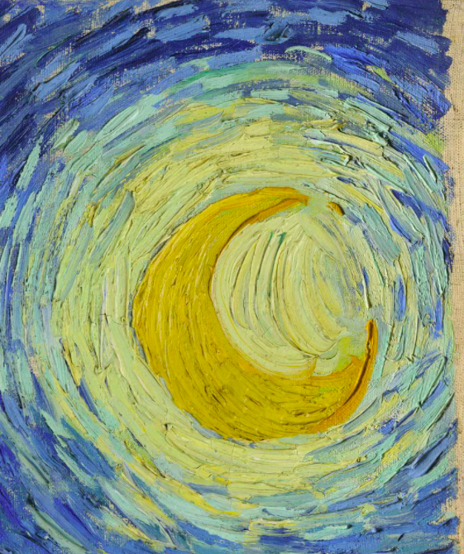
Unit 6: Do Activity #1
Slide #6.1
After reviewing the PowerPoint presentation, complete the following activity:
The Impressionist painters did not blend their paint together: rather, they left each brushstroke to stand alone. Using a simple set of markers, re-create a portion of one Impressionist painting. Colors and the finished product do not matter. This is to replicate the patterns of brushstrokes you see in a painting Share your creations in a discussion board.
https://artsandculture.google.com/story/9gXhd4wX07NFMA
Notes:
Interactive PowerPoint will be provided by Instructional Design. Link to highlighted features of Van Gogh will be provided in Unit 6’s content. Feedback will be provided by peers through the discussion board and by the instructor through the grading center.

Slide 26
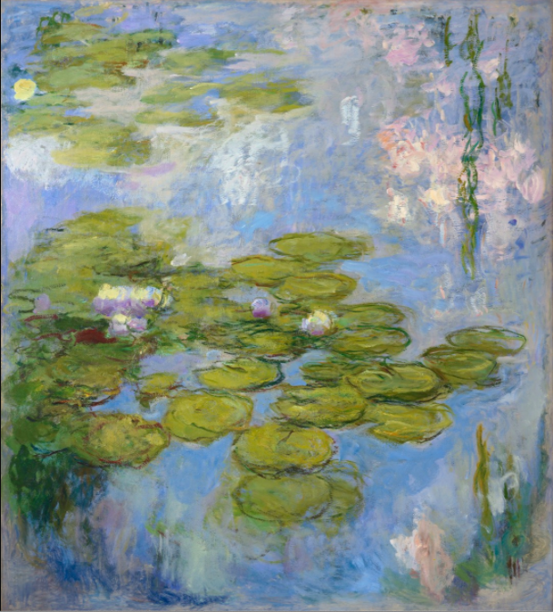
Unit 6: Do Activity #2
Slide #6.2
After reviewing the PowerPoint presentation, complete the following activity:
Develop a Prezi presentation analyzing 4 pieces of art or architecture: two from Unit 5 and two from Unit 6. Share your presentation in the provided discussion thread and discuss your project and those of your peers.
https://prezi.com/
Notes:
Students will be provided instructions for the Prezi presentation and the Discussion Board. Links will be provided in Blackboard to submit their assignments. Instructions for using Prezi will be provided within the assignment instructions. A link to Prezi will be provided in Unit resources.

Slide 27
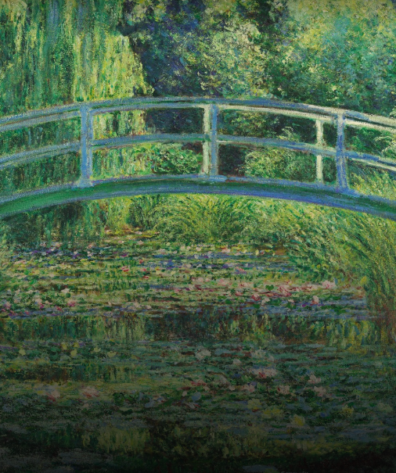
Unit 6: Connect Activity
Slide #6.3
Zoom into a Monet painting using the following weblink: https://artsandculture.google.com/story/monet-the-water-lily-pond/WgIS72lKcegxJQ
Search for the fine details not otherwise seen in a photograph. Discuss how “abstract” the painted patterns become when seen close-up.
https://post.blackboard.com/webapps/portal/execute/tabs/tabAction?tab_tab_group_id=_646_1
Notes:
Link will be available under the content section of Unit 6 in Blackboard. Feedback will be provided directly from peers in the discussion board and from the instructor in the Grade Center.

Slide 28
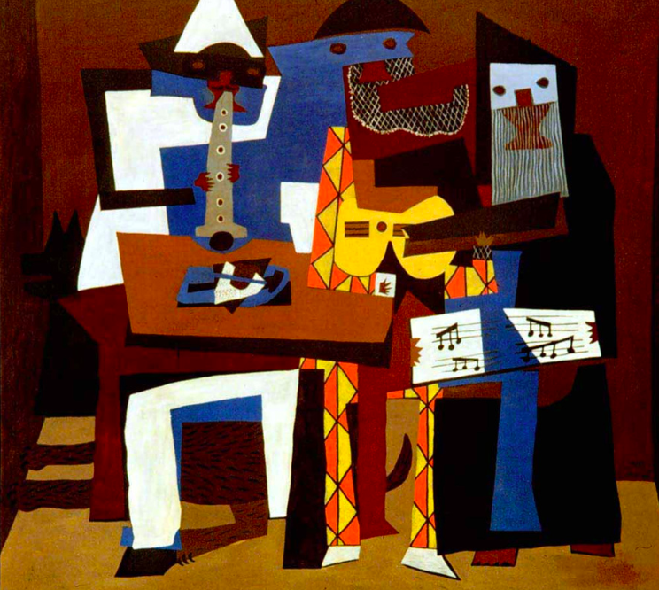
Unit 7: Toward Abstraction: The Modernist Movement
Slide #7
Absorb Activity:
Watch a video created by art historians describing how to formally analyze modern and abstract art.
https://www.youtube.com/watch?v=1E91KmfiUGY
Notes:
The video will be presented as a Mash-Up where students can click to open a small window or click to go directly to the YouTube site.

Slide 29
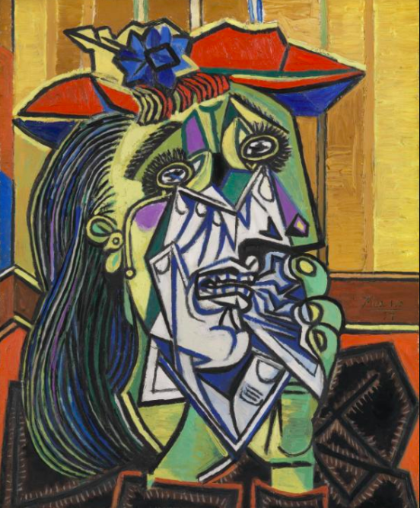
Unit 7: Do Activity #1
Slide #7.1
After reviewing the video, participate in the following discussion:
The move towards Modernism in art sees a great many changes in aesthetics, art purpose, and subject matter. Choose the one piece of art that challenges you the most and share your thoughts on why this was made the way it was in a discussion board.
https://post.blackboard.com/webapps/portal/execute/tabs/tabAction?tab_tab_group_id=_646_1
Notes:
Link will be available under the content section of Unit 7 in Blackboard. Feedback will be provided directly from peers in the discussion board and from the instructor in the Grade Center.

Slide 30
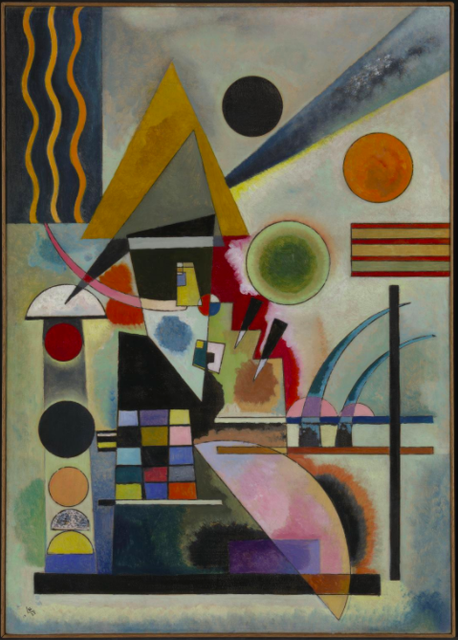
Unit 7: Do Activity #2
Slide #7.2
After reviewing the video, complete the following activity:
Write a reflective paper on the progression of art from the various forms of representation to abstraction, focusing on analyzing the movements and artists in your own words. Share your draft on the class website for feedback.
https://post.blackboard.com/webapps/portal/execute/tabs/tabAction?tab_tab_group_id=_646_1
Notes:
Directions and navigation will be presented to enrolled students through Blackboard. A link will be provided for students to submit their paper on the class website, and feedback will be supplied directly from the instructor through the grading center.

Slide 31
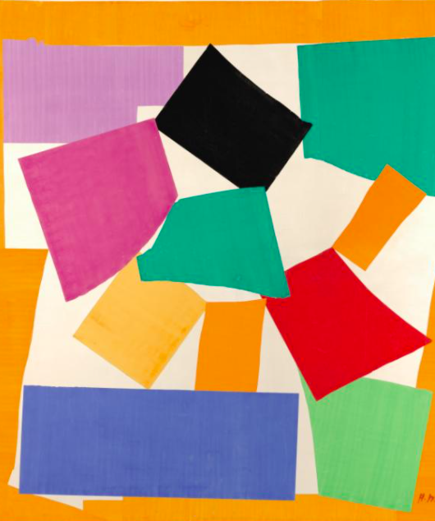
Unit 7: Connect Activity
Slide #7.3
Research the artist you selected as the most challenging to you visually. Discover their story, their work, and their influences.
Write a “biography” of this selected artist based on your research.
https://post.blackboard.com/webapps/portal/execute/tabs/tabAction?tab_tab_group_id=_646_1
Notes:
Directions and navigation will be presented to enrolled students through Blackboard. A link will be provided for students to submit their paper, and feedback will be supplied directly from the instructor through the grading center.

Slide 32
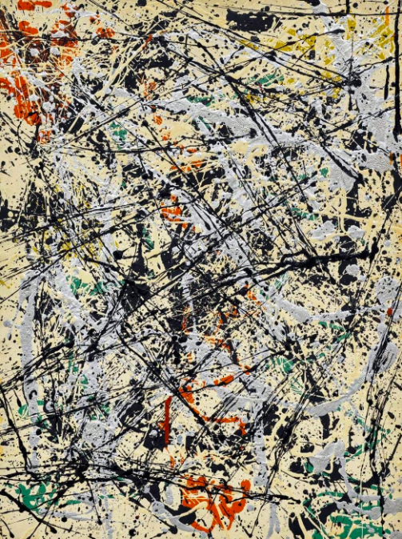
Unit 8: Postwar to Postmodern
Slide #8
Absorb Activity:
Explore textbook chapters highlighting individual artists and their work with descriptions on how to “read” the work formally.
https://post.edu/student-services/library/virtual-library/
Notes:
Links will be provided to a University approved art history textbook through their online library. Students will be directed to each required chapter through text clicks.

Slide 33
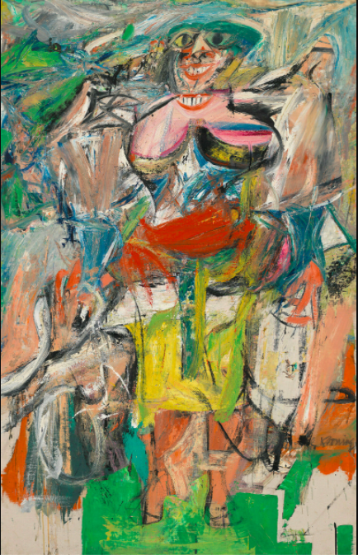
Unit 8: Do Activity #1
Slide #8.1
After reading the textbook, complete the following activity:
Participate in the interactive Jeopardy game reviewing content from all Units. Play with your peers as a group activity and see who wins!
http://www.coursematerials.net/multimediaservices/
Notes:
Instructional Design team members at Post will design an interactive Jeopardy game using terms provided by the SME. outlining key works of art and analysis of each. Students will be able to click on an image of art which will open a window with the analysis. The provided link is a video outlining some of the services they provide for Instructional Design.

Slide 34
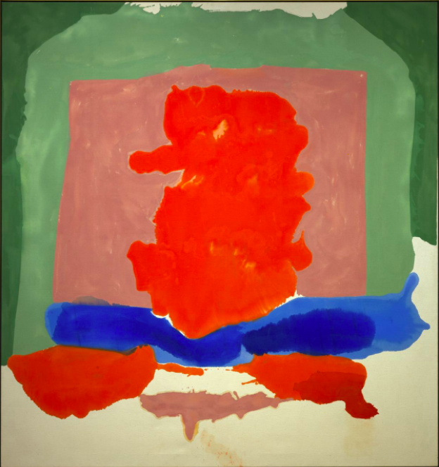
Unit 8: Do Activity #2
Slide #8.2
After reading the textbook, complete the following activity:
Review all feedback from your previous presentations and compile all into one final presentation. Add four more slides analyzing two pieces of art from Unit 7 and two from Unit 8. Discuss this process in the discussion board with your peers.
https://post.blackboard.com/webapps/portal/execute/tabs/tabAction?tab_tab_group_id=_646_1
Notes:
Link will be available under the content section of Unit 8 in Blackboard. Feedback will be provided directly from peers in the discussion board and from the instructor in the Grade Center.

Slide 35
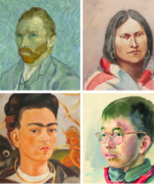
Unit 8: Connect Activity
Slide #8.3
As a culmination activity, create an account at the following link: https://artsandculture.google.com/camera/selfie
Using a “selfie,” search through various artistic styles from our class and see how they are used to create works of art from your image. Discuss how the various styles represent the eras we’ve studied, and comment on your experience with this scavenger hunt.
Notes:
Link to Google’s interactive selfie game will be provided in Unit 8’s content. Feedback will be provided by peers through the discussion board and by the instructor through the grading center.

Slide 36
Conclusion
The development of Art History II for Post University includes a variety of Absorb, Do, and Connect Activities to ensure an immersive, interactive learning experience. Interactive content brings the content to life and relates Art History to students’ experiences and enhances personal growth.
Upon completion of the course, students will have established an educational experience where Art History is proven to be relevant to their personal and academic goals. It is our hope that students will find this class informative and enjoyable, which will encourage them to pursue other Art classes at Post.

Slide 37
References
Bambach, C. (2002). Anatomy in the renaissance. Metropolitan Museum of Art. Retrieved from: https://www.metmuseum.org/toah/hd/anat/hd_anat.htm
Coursematerials.net. (n.d.). Retrieved from: http://www.coursematerials.net/multimediaservices/
CrashCourse. (2019, Apr. 19). Florence and the renaissance: Crash course European history. [YouTube]. Retrieved from: https://www.youtube.com/watch?v=tecocKSclwc&vl=en
Google Arts and Culture. (n.d.). Retrieved from: https://artsandculture.google.com/
Metropolitan Museum of Art. (2002). Architecture in renaissance Italy. Retrieved from: https://www.metmuseum.org/toah/hd/itar/hd_itar.htm

Slide 38
References (continued)
Post University (n.d.). Virtual Library Resources. Retrieved from: https://post.edu/student-services/library/virtual-library/
Post University Blackboard. (n.d.). Retrieved from: https://post.blackboard.com/webapps/portal/execute/tabs/tabAction?tab_tab_group_id=_646_1
Prezi. (n.d.). Retrieved from: https://prezi.com/
Quizlet. (n.d.). Retrieved from: https://quizlet.com/latest
Smarthistory. (2017, May 10). Picasso, still life with chair caning. [YouTube]. Retrieved from: https://www.youtube.com/watch?v=1E91KmfiUGY
Zoom. (n.d.). Retrieved from: https://zoom.us/

