Slide 1
Online Art History II Development
Tracy Collamore
This project will be the creation of an online Art History 2 course that can be used for Post University’s online program. Art History is a popular undergraduate course at Post as it provides an interesting topic for a Humanities credit. The current shell for Art History 2 is outdated, so this is an opportunity to create a better one through the information learning in E-Learning Design for Diverse Environments. The project will be divided into 8 Units, arranged in historical, chronological order, starting with the Renaissance.
Color and font choices are based on Post University’s recent branding changes from green and white to orange and purple. Orange and purple will be used throughout the storyboard.
Font will be Century Gothic, 12pt. It is a clean and simple font, easy to read, and closely matches the Post University logo text.
Notes:
Navigation through the course will be as designed in Post’s online Blackboard shells where each Unit, Course Information, Grade Center, etc. are provided as a list on the left-hand side of the computer screen. Clicking the text will direct the student to the desired content.

Slide 2

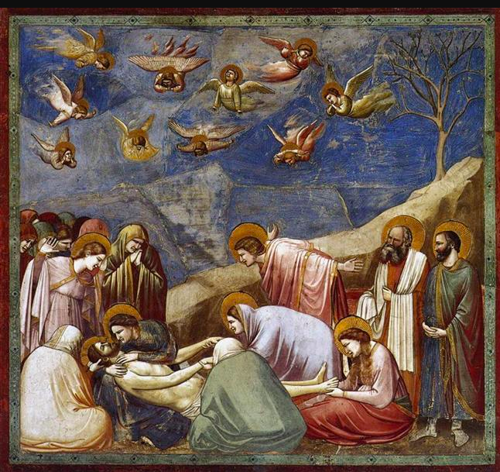
Unit 1: 13th-15th Century Italy and Northern Europe
Slide #1
Absorb Activity:
Explore Unit 1’s content in an interactive presentation, including images of major works of art and scholarly analyses of each from the Art History textbook.
Notes:
Instructional Design team members at Post would be given a PowerPoint Presentation outlining key works of art and analysis of each. Students will be able to click on an image of art which will open a window with the analysis.

Slide 3
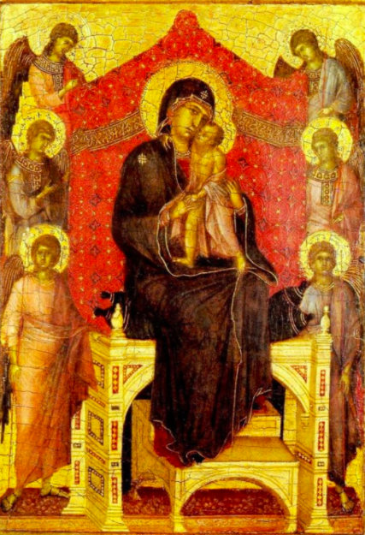
Unit 1: Do Activity #1
Slide #1.1
After reviewing the interactive content, participate in this discussion:
Artists in the Early stages of the Renaissance are starting to incorporate nature, spatial concerns, and three-dimensionality. Choose one example of art from the interactive content and formally analyze how the artist is considering these new ideas.

Slide 4
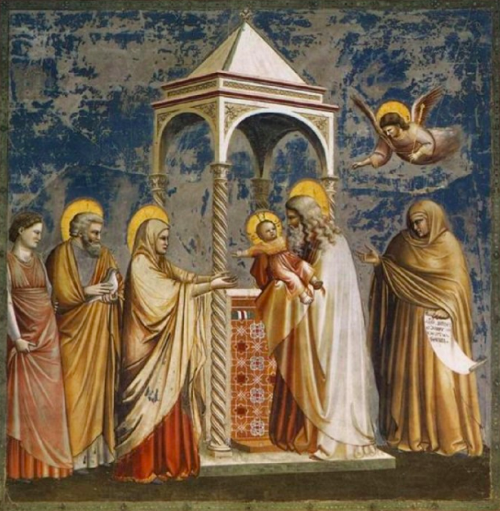
Unit 1: Do Activity #2
Slide #1.2
After reviewing the interactive content, participate in this discussion:
Consider the work of Giotto and how it is unique to the other examples of art from this time period. Compare one work of Giotto with another from the content and contrast differences through a formal analysis.

Slide 5
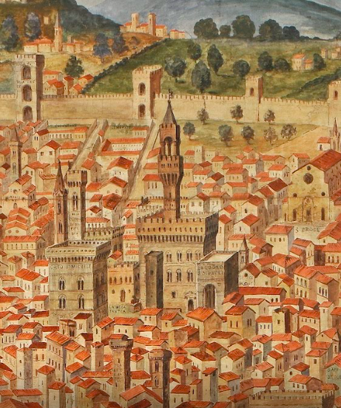

Unit 1: Connect Activity
Slide #1.3
Go on a Scavenger Hunt virtually in Florence, Italy. Search for influences in architecture from the 13th-14th centuries throughout the city. Explore the 360-degree images as well as the drawings and content: https://artsandculture.google.com/exhibit/la-veduta-della-catena-florence-and-its-monuments/JAIiVU6eaWEIJQ
Connect your search with the Unit content and write a paper revealing your discoveries.
(Feedback will be provided through the Blackboard Grading System)

Slide 6
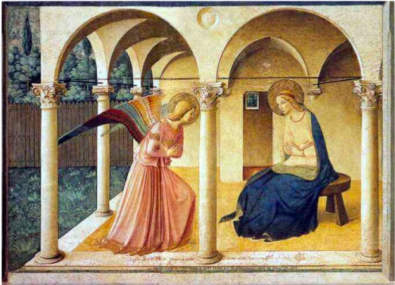
Unit 2: The Early and High Renaissance in Italy
Slide #2
Absorb Activity:
Read articles written by art historians and discover how professionals analyze various works of art from the Renaissance.
https://www.metmuseum.org/toah/hd/itar/hd_itar.htm
https://www.metmuseum.org/toah/hd/anat/hd_anat.htm
Notes:
Links to scholarly articles will be delivered as a text-click navigation.

Slide 7
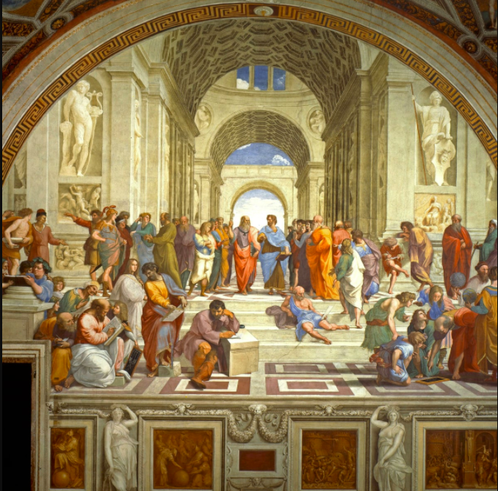
Unit 2: Do Activity #1
Slide #2.1
After reading the provided articles, complete the following activity:
Using the interactive project provided, play a matching game as many times as you need to earn an A score. Match artists with their work as well as terms with their definitions.

Slide 8
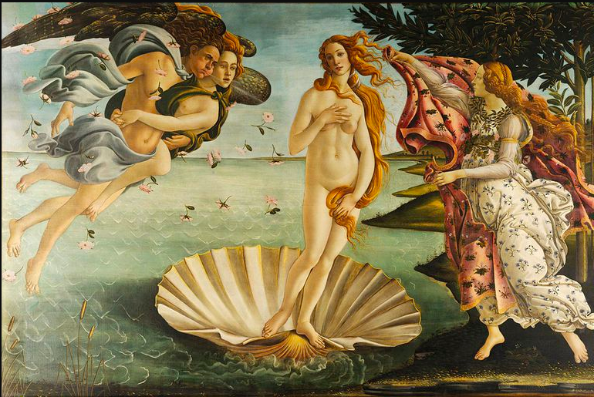
Unit 2: Do Activity #2
Slide #2.2
After reading the provided articles, complete the following activity:
Develop a Prezi presentation analyzing 4 pieces of art or architecture: two from Unit 1 and two from Unit 2. Share your presentation in the provided discussion thread and discuss your project and those of your peers.

Slide 9
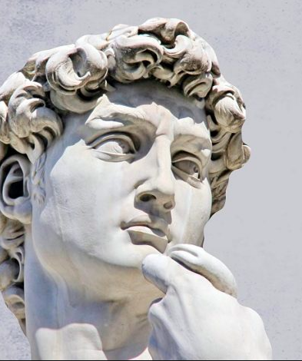
Unit 2: Connect Activity
Slide #2.3
Research the life of Michelangelo and his greatest artistic achievements in both art and architecture. See how his work influenced many more who followed.
Write about your research and include at least two artists who were influenced by him, and how.
(Feedback will be provided through the Blackboard Grading System)

Slide 10
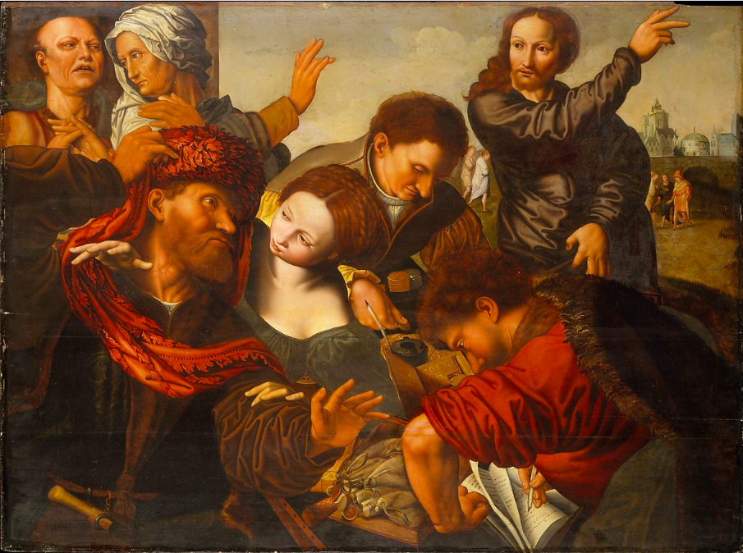
Unit 3: The Late Renaissance and Reformation
Slide #3
Absorb Activity:
Watch a video summarizing how societal trends affected artwork in each category of the historical periods.
https://www.youtube.com/watch?v=tecocKSclwc&vl=en
Notes:
The video will be presented as a Mash-Up where students can click to open a small window or click to go directly to the YouTube site.

Slide 11
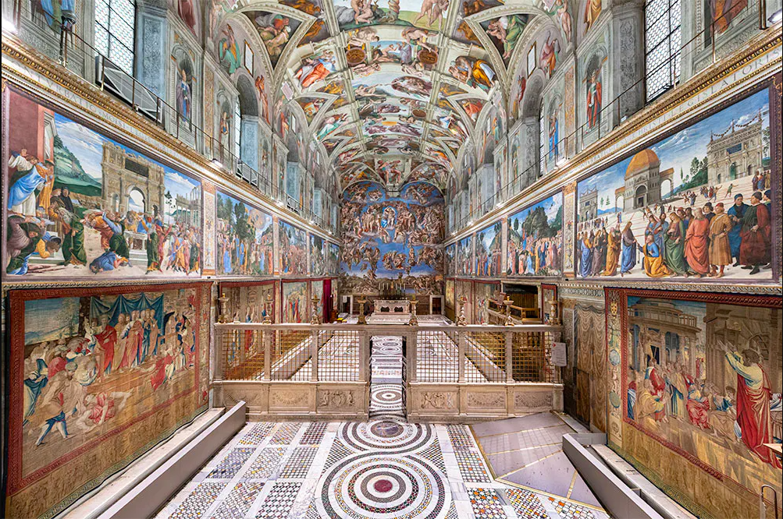
Unit 3: Do Activity #1
Slide #3.1
After watching the video, complete the following activity:
Virtually discover the Sistine Chapel in Rome through Google Arts and Culture. Explore the site thoroughly, then discuss your experiences in a discussion board.

Slide 12
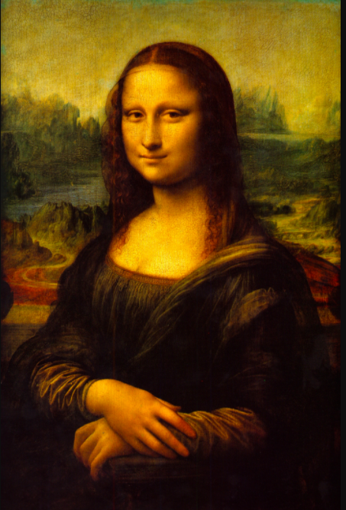
Unit 3: Do Activity #2
Slide #3.2
After watching the video, complete the following activity:
Write a reflective paper on the progression of art and architecture during the Reformation, focusing on analyzing the movements and artists in your own words. Share your drafts to a class website and review others’ work by adding feedback. Revise your draft with feedback given to you.

Slide 13
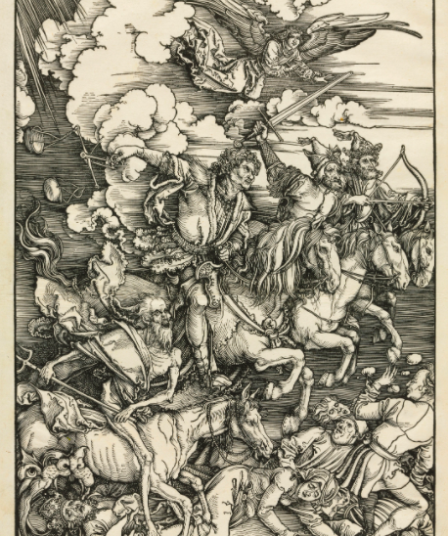
Unit 3: Connect Activity
Slide #3.3
After reviewing the Unit’s content, engage in a virtual group critique with your peers and instructor through Zoom.
To prepare, choose one artist from Unit 3, search for more information, and present your findings in the virtual meeting. Peers will provide critiques on your work and you will critique your peers.
(Feedback will be provided throughout the Zoom meeting)

Slide 14
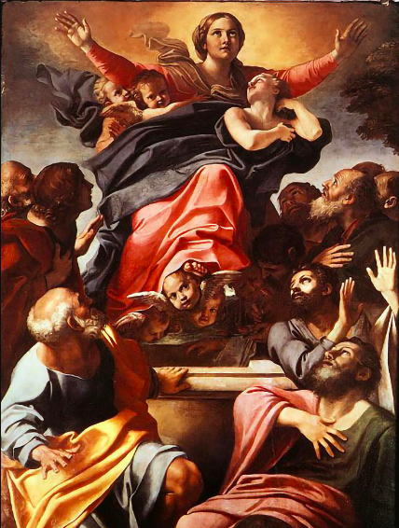
Unit 4: The Baroque in Western Europe
Slide #4
Absorb Activity
Discover the societal changes that continue to affect the Baroque movement throughout Western Europe through an interactive presentation.
Notes:
Instructional Design team members at Post would be given a PowerPoint Presentation outlining key works of art and analysis of each. Students will be able to click on an image of art which will open a window with the analysis.

Slide 15
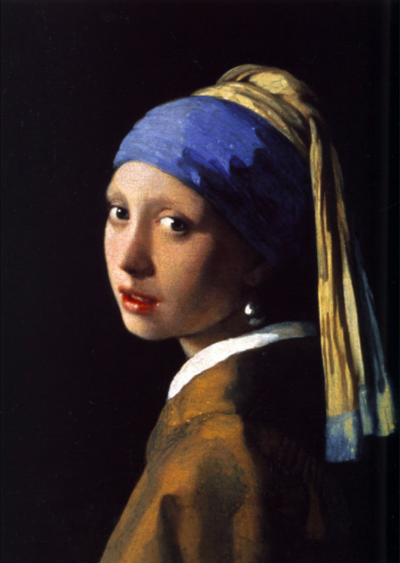
Unit 4: Do Activity #1
Slide #4.1
After reviewing the interactive content, complete the following activity:
Using the interactive project from Quizlet provided, play the Asteroids simulation matching artists to their work. Play as many times as you need to earn an A score. Discuss your experience in a discussion board.

Slide 16
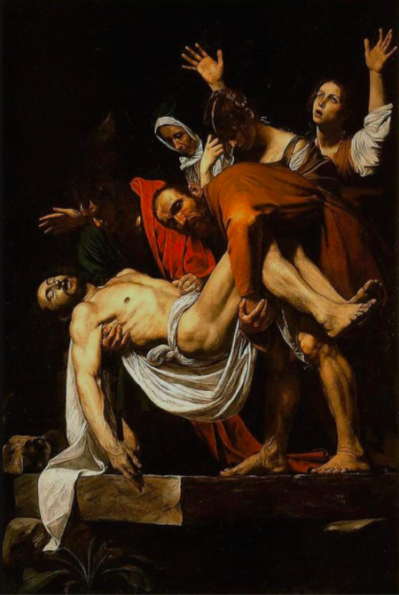
Unit 4: Do Activity #2
Slide #4.2
After reviewing the interactive content, complete the following activity:
Develop a Prezi presentation analyzing 4 pieces of art or architecture: two from Unit 3 and two from Unit 4. Share your presentation in the provided discussion thread and discuss your project and those of your peers.

Slide 17
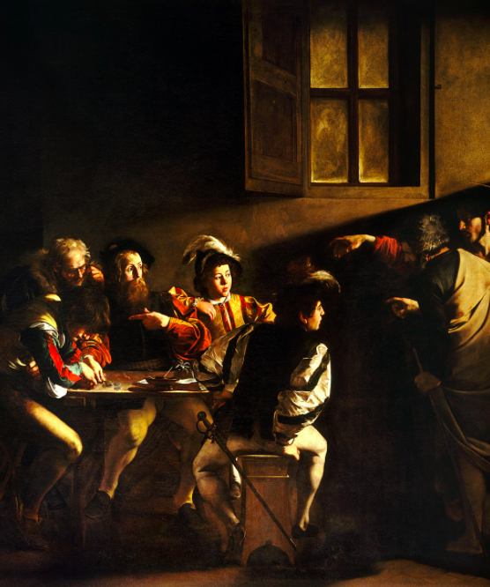
Unit 4: Connect Activity
Slide #4.3
Using the following weblink, (https://artsandculture.google.com/story/the-night-watch/dALSivMco4xIJA) go on a visual scavenger hunt in Rembrandt’s paintings.
Discover the intricate details and painting process not otherwise seen in a photograph. Share your discoveries in a reflective paper.
(Feedback will be provided through the Blackboard Grading System)

Slide 18
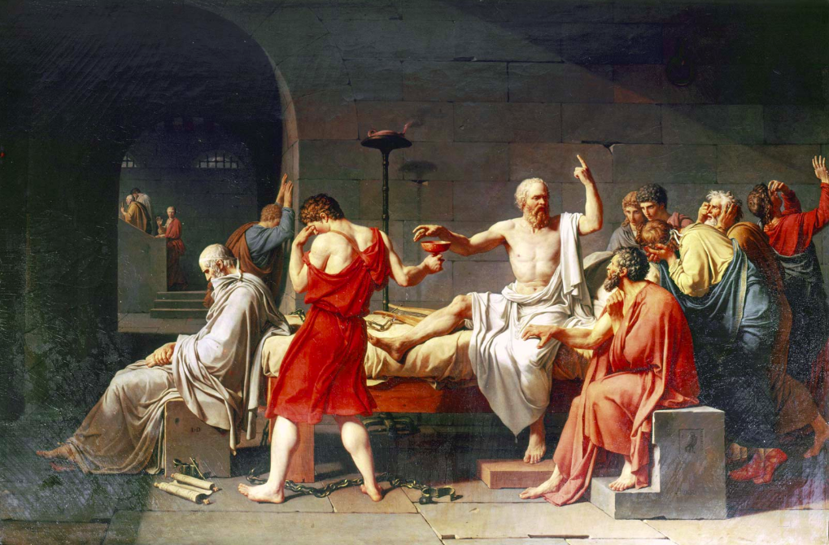
Unit 5: The Age of Enlightenment and Romanticism
Slide #5
Absorb Activity:
Read the chapters from your textbook describing the changes in art during the Age of Enlightenment and Romanticism.
Notes:
Links will be provided to a University approved art history textbook through their online library. Students will be directed to each required chapter through text clicks.

Slide 19
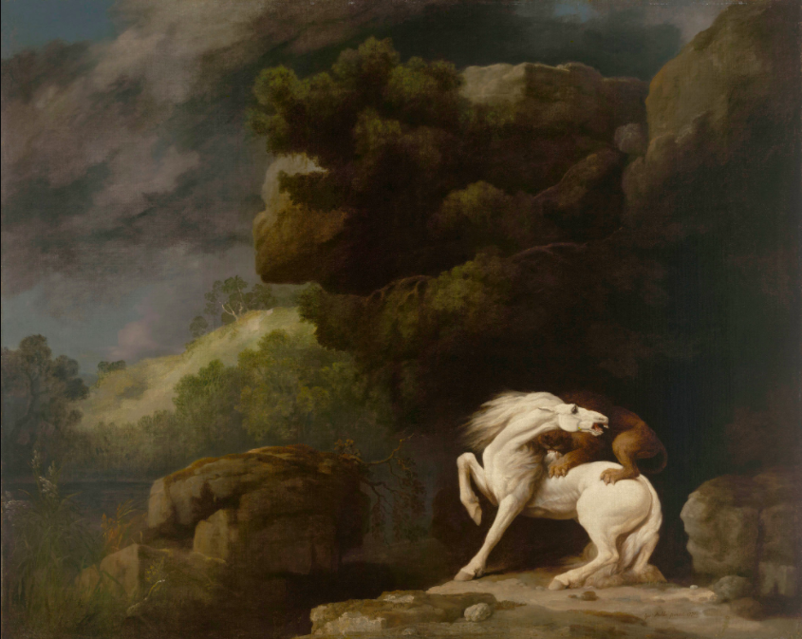
Unit 5: Do Activity #1
Slide #5.1
After reviewing the readings, participate in this discussion:
The Age of Enlightenment sees a large shift in artistic creations and purpose. Consider Neo-Classicism and compare/contrast with each other. Reply to your peers with your thoughts.

Slide 20
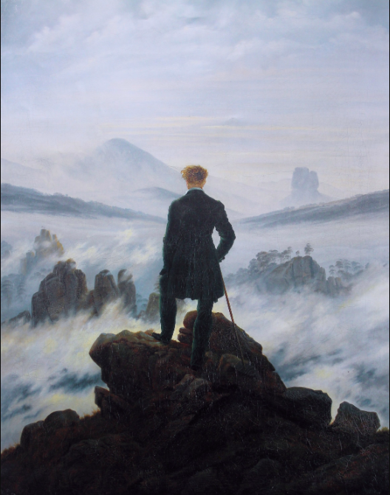
Unit 5: Do Activity #2
Slide #5.2
After reading the textbook, complete the following activity:
Write a reflective paper on the progression of art from the Renaissance to the Age of Enlightenment, focusing on analyzing the movements and artists in your own words. Share your draft on the class website for feedback.

Slide 21
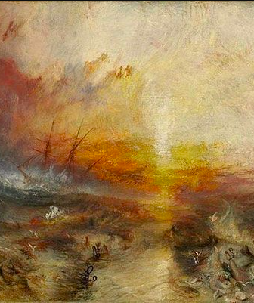
Unit 5: Connect Activity
Slide #5.3
Research the movement of Romanticism in art and music. Discover the similarities and differences of artists from all media using the influences of the principles of Romanticism. Share your discoveries in a paper.
(Feedback will be provided through the Blackboard Grading System)

Slide 22
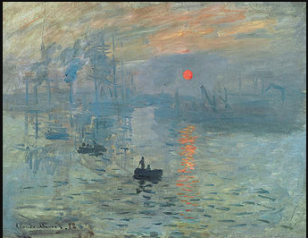
Unit 6: Realism, Impressionism, and Post-Impressionism
Slide #6
Absorb Activity:
Explore a PowerPoint presentation highlighting the key works of art from the Impressionist movement, discovering how each individual artist created a unique style based on similar ideas.
Notes:
Instructional Design team members at Post would be given a PowerPoint Presentation outlining key works of art and analysis of each. Students will be able to click on an image of art which will open a window with the analysis.

Slide 23
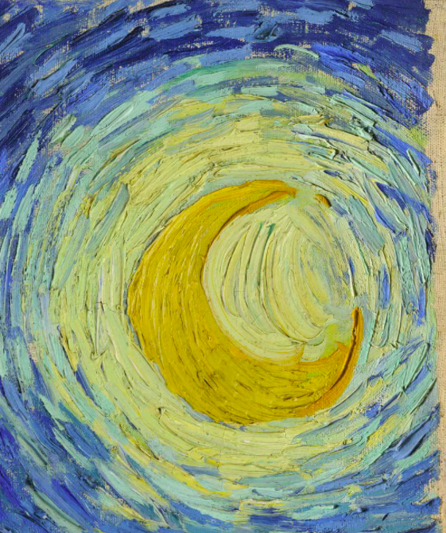
Unit 6: Do Activity #1
Slide #6.1
After reviewing the PowerPoint presentation, complete the following activity:
The Impressionist painters did not blend their paint together: rather, they left each brushstroke to stand alone. Using a simple set of markers, re-create a portion of one Impressionist painting. Colors and the finished product do not matter. This is to replicate the patterns of brushstrokes you see in a painting.

Slide 24
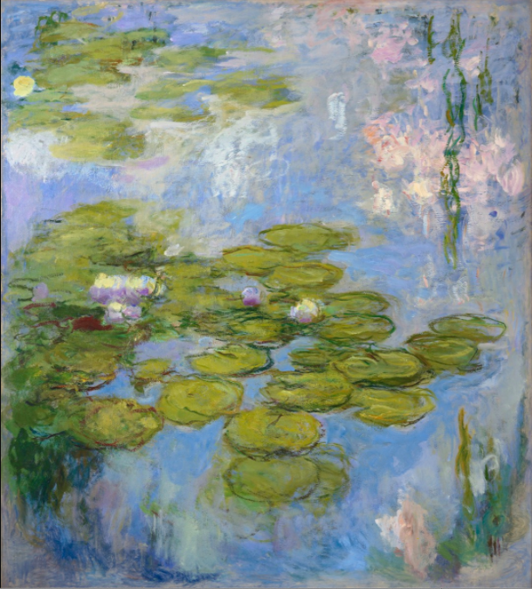
Unit 6: Do Activity #2
Slide #6.2
After reviewing the PowerPoint presentation, complete the following activity:
Develop a Prezi presentation analyzing 4 pieces of art or architecture: two from Unit 5 and two from Unit 6. Share your presentation in the provided discussion thread and discuss your project and those of your peers.

Slide 25
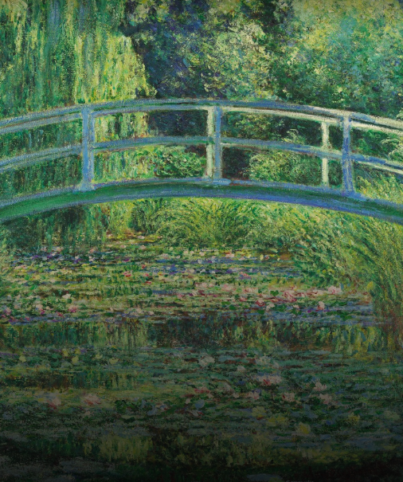
Unit 6: Connect Activity
Slide #6.3
Zoom into a Monet painting using the following weblink: https://artsandculture.google.com/story/monet-the-water-lily-pond/WgIS72lKcegxJQ
Search for the fine details not otherwise seen in a photograph. Discuss how “abstract” the painted patterns become when seen close-up
(Feedback will be provided through the Blackboard Discussion Forum)

Slide 26
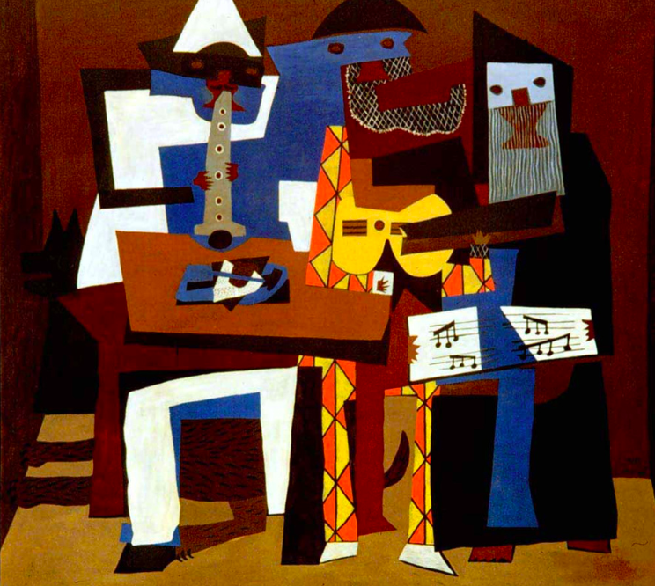
Unit 7: Toward Abstraction: The Modernist Movement
Slide #7
Absorb Activity:
Watch a video created by art historians describing how to formally analyze modern and abstract art.
https://www.youtube.com/watch?v=1E91KmfiUGY
Notes:
The video will be presented as a Mash-Up where students can click to open a small window or click to go directly to the YouTube site.

Slide 27
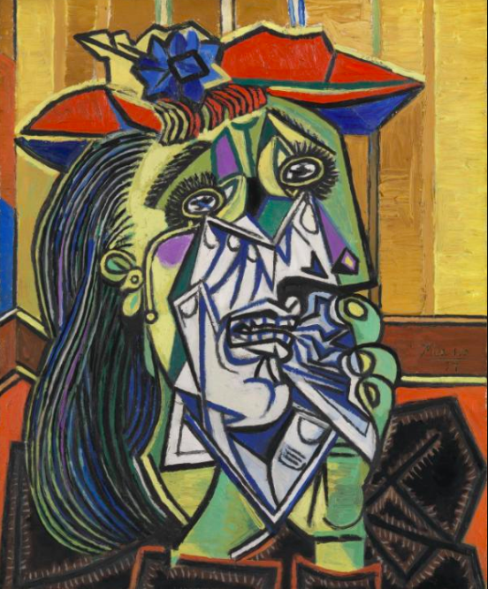
Unit 7: Do Activity #1
Slide #7.1
After reviewing the video, participate in the following discussion:
The move towards Modernism in art sees a great many changes in aesthetics, art purpose, and subject matter. Choose the one piece or art that you challenges you the most and share your thoughts on my this was made the way it was.

Slide 28
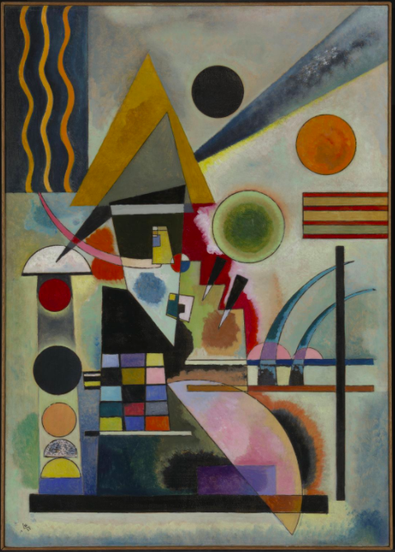
Unit 7: Do Activity #2
Slide #7.2
After reviewing the video, complete the following activity:
Write a reflective paper on the progression of art from the various forms of representation to abstraction, focusing on analyzing the movements and artists in your own words. Share your draft on the class website for feedback.

Slide 29
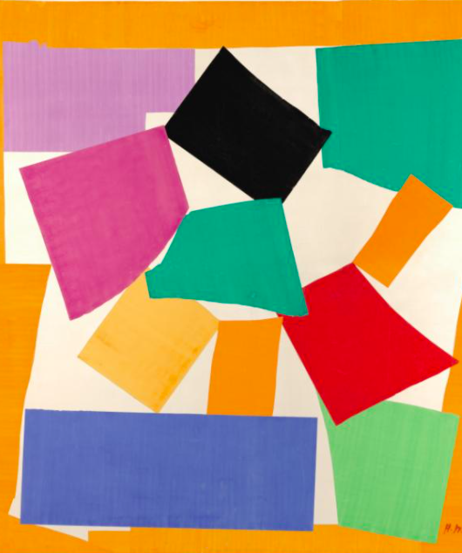
Unit 7: Connect Activity
Slide #7.3
Research the artist you selected as the most challenging to you visually. Discover their story, their work, and their influences.
Write a “biography” of this selected artist based on your research.
(Feedback will be provided through the Blackboard Grading System)

Slide 30
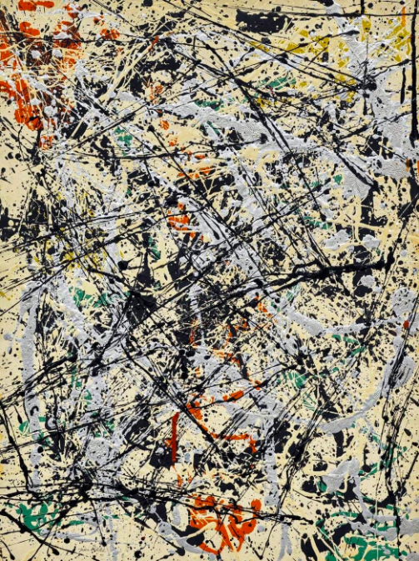
Unit 8: Postwar to Postmodern
Slide #8
Absorb Activity:
Explore textbook chapters highlighting individual artists and their work with descriptions on how to “read” the work formally.
Notes:
Links will be provided to a University approved art history textbook through their online library. Students will be directed to each required chapter through text clicks.

Slide 31
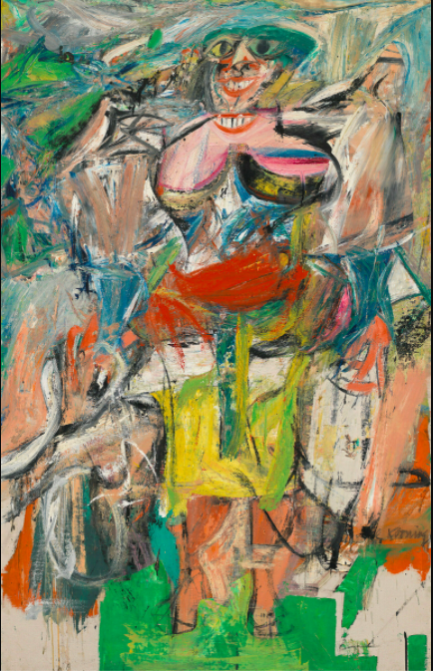
Unit 8: Do Activity #1
Slide #8.1
After reading the textbook, complete the following activity:
Participate in the interactive Jeopardy game reviewing content from all Units. Play with your peers as a group activity and see who wins!

Slide 32
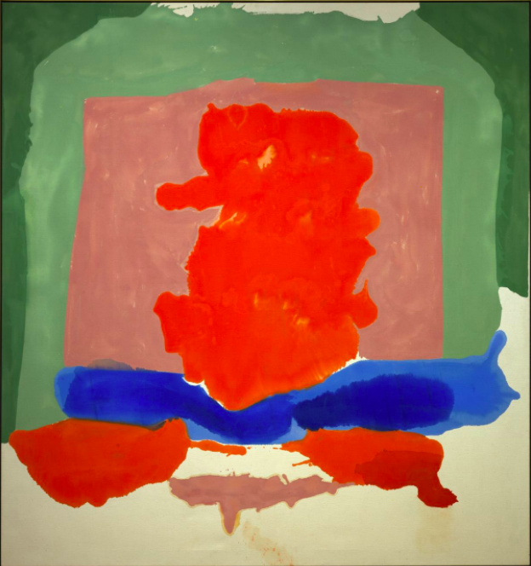
Unit 8: Do Activity #2
Slide #8.2
After reading the textbook, complete the following activity:
Review all feedback from your previous presentations and compile all into one final presentation. Add four more slides analyzing two pieces of art from Unit 7 and two from Unit 8. Discuss this process in the discussion board with your peers.

Slide 33
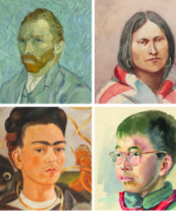
Unit 8: Connect Activity
Slide #8.3
As a culmination activity, create an account at the following link: https://artsandculture.google.com/camera/selfie
Using a “selfie,” search through various artistic styles from our class and see how they are used to create works of art from your image. Discuss how the various styles represent the eras we’ve studied, and comment on your experience with this scavenger hunt.
(Feedback will be provided through the Blackboard Discussion Forum)

Slide 34
References
Bambach, C. (2002). Anatomy in the renaissance. Metropolitan Museum of Art. Retrieved from: https://www.metmuseum.org/toah/hd/anat/hd_anat.htm
CrashCourse. (2019, Apr. 19). Florence and the renaissance: Crash course European history. [YouTube]. Retrieved from: https://www.youtube.com/watch?v=tecocKSclwc&vl=en
Metropolitan Museum of Art. (2002). Architecture in renaissance Italy. Retrieved from: https://www.metmuseum.org/toah/hd/itar/hd_itar.htm
Smarthistory. (2017, May 10). Picasso, still life with chair caning. [YouTube]. Retrieved from: https://www.youtube.com/watch?v=1E91KmfiUGY

