Slide 1
Online Art History II Development
Tracy Collamore
This project will be the creation of an online Art History 2 course that can be used for Post University’s online program. Art History is a popular undergraduate course at Post as it provides an interesting topic for a Humanities credit. The current shell for Art History 2 is outdated, so this is an opportunity to create a better one through the information learning in E-Learning Design for Diverse Environments. The project will be divided into 8 Units, arranged in historical, chronological order, starting with the Renaissance.
Color and font choices are based on Post University’s recent branding changes from green and white to orange and purple. Orange and purple will be used throughout the storyboard.
Font will be Century Gothic, 12pt. It is a clean and simple font, easy to read, and closely matches the Post University logo text.
Navigation through the course will be as designed in Post’s online Blackboard shells where each Unit, Course Information, Grade Center, etc. are provided as a list on the left-hand side of the computer screen. Clicking the text will direct the student to the desired content.

Slide 2

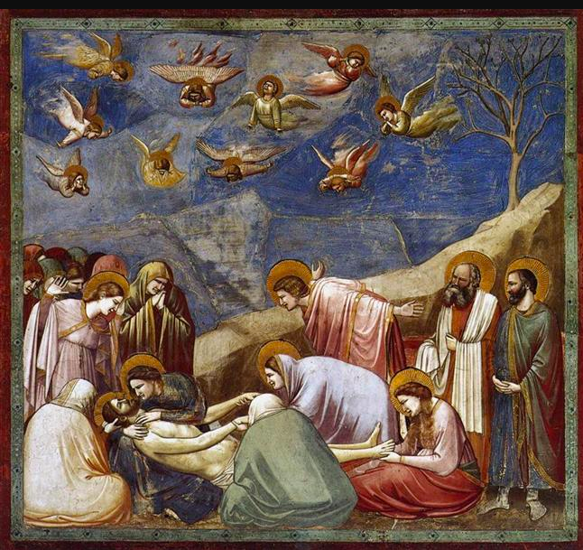
Unit 1: 13th-15th Century Italy and Northern Europe
Slide #1
Absorb Activity:
Explore Unit 1’s content in an interactive presentation, including images of major works of art and scholarly analyses of each from the Art History textbook.
Instructional Design team members at Post would be given a PowerPoint Presentation outlining key works of art and analysis of each. Students will be able to click on an image of art which will open a window with the analysis.

Slide 3
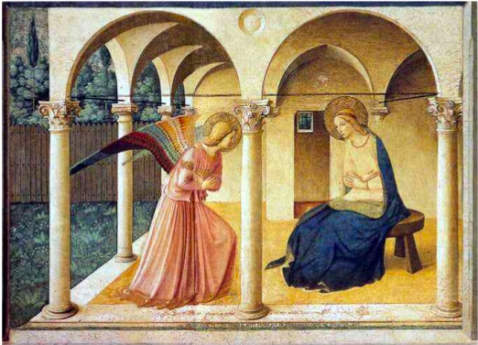
Unit 2: The Early and High Renaissance in Italy
Slide #2
Absorb Activity:
Read articles written by art historians and discover how professionals analyze various works of art from the Renaissance.
https://www.metmuseum.org/toah/hd/itar/hd_itar.htm
https://www.metmuseum.org/toah/hd/anat/hd_anat.htm
Links to scholarly articles will be delivered as a text-click navigation.

Slide 4
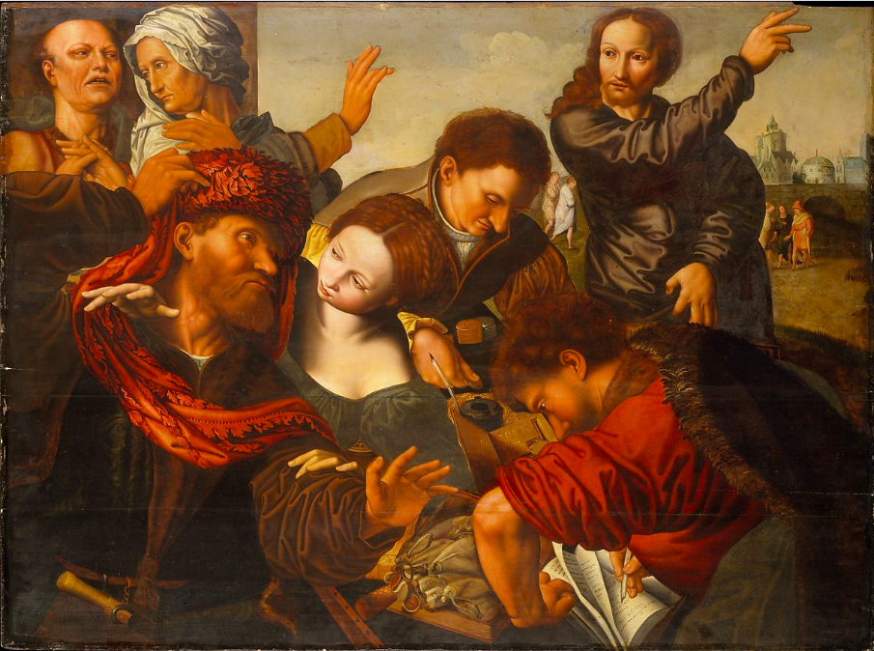
Unit 3: The Late Renaissance and Reformation
Slide #3
Absorb Activity:
Watch a video summarizing how societal trends affected artwork in each category of the historical periods.
https://www.youtube.com/watch?v=tecocKSclwc&vl=en
The video will be presented as a Mash-Up where students can click to open a small window or click to go directly to the YouTube site.

Slide 5
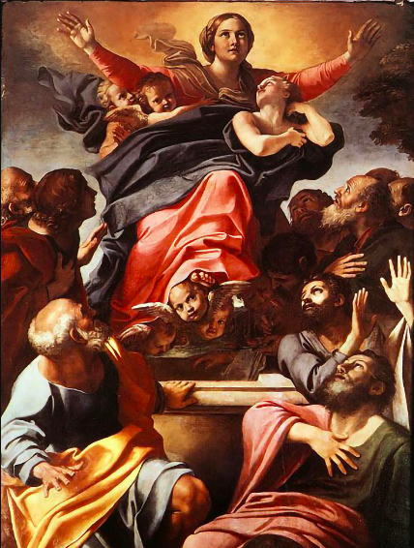
Unit 4: The Baroque in Western Europe
Slide #4
Absorb Activity
Discover the societal changes that continue to affect the Baroque movement throughout Western Europe through an interactive presentation.
Instructional Design team members at Post would be given a PowerPoint Presentation outlining key works of art and analysis of each. Students will be able to click on an image of art which will open a window with the analysis.

Slide 6
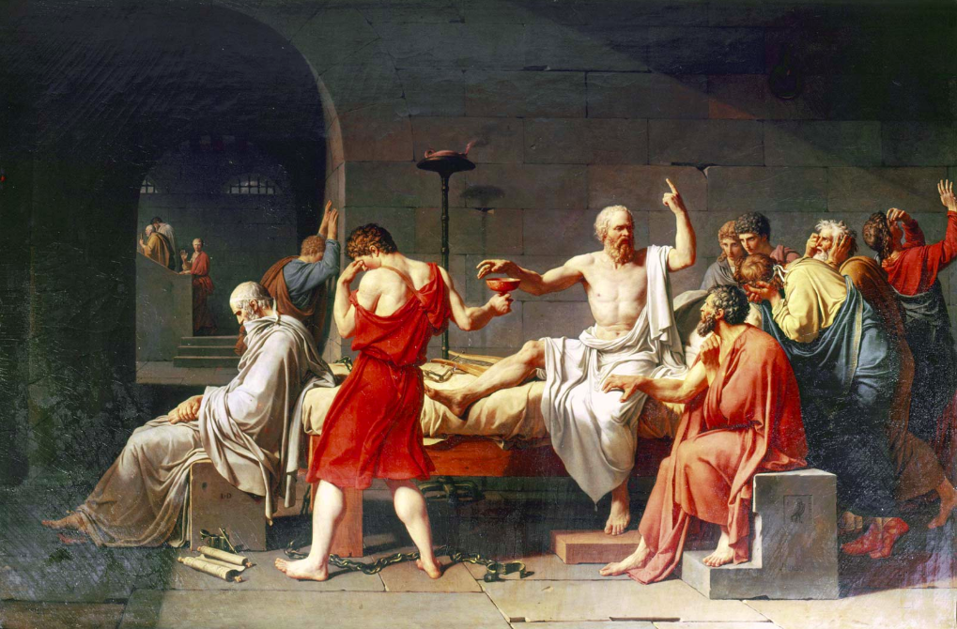
Unit 5: The Age of Enlightenment and Romanticism
Slide #5
Absorb Activity:
Read the chapters from your textbook describing the changes in art during the Age of Enlightenment and Romanticism.
Links will be provided to a University approved art history textbook through their online library. Students will be directed to each required chapter through text clicks.

Slide 7
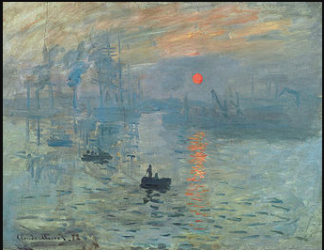
Unit 6: Realism, Impressionism, and Post-Impressionism
Slide #6
Absorb Activity:
Explore a PowerPoint presentation highlighting the key works of art from the Impressionist movement, discovering how each individual artist created a unique style based on similar ideas.
Instructional Design team members at Post would be given a PowerPoint Presentation outlining key works of art and analysis of each. Students will be able to click on an image of art which will open a window with the analysis.

Slide 8
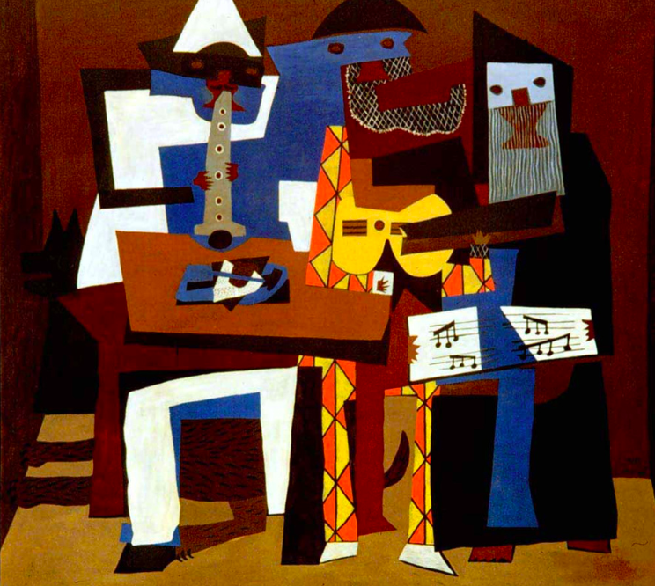
Unit 7: Toward Abstraction: The Modernist Movement
Slide #7
Absorb Activity:
Watch a video created by art historians describing how to formally analyze modern and abstract art.
https://www.youtube.com/watch?v=1E91KmfiUGY
The video will be presented as a Mash-Up where students can click to open a small window or click to go directly to the YouTube site.

Slide 9
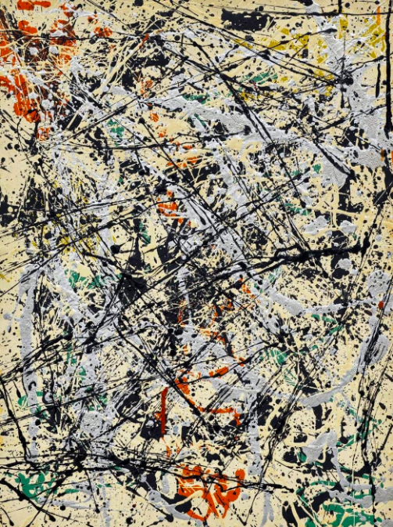
Unit 8: Postwar to Postmodern
Slide #8
Absorb Activity:
Explore textbook chapters highlighting individual artists and their work with descriptions on how to “read” the work formally.
Links will be provided to a University approved art history textbook through their online library. Students will be directed to each required chapter through text clicks.

Slide 10
References
Bambach, C. (2002). Anatomy in the renaissance. Metropolitan Museum of Art. Retrieved from: https://www.metmuseum.org/toah/hd/anat/hd_anat.htm
CrashCourse. (2019, Apr. 19). Florence and the renaissance: crash course European history. [YouTube]. Retrieved from: https://www.youtube.com/watch?v=tecocKSclwc&vl=en
Metropolitan Museum of Art. (2002). Architecture in renaissance Italy. Retrieved from: https://www.metmuseum.org/toah/hd/itar/hd_itar.htm
Smarthistory. (2017, May 10). Picasso, still life with chair caning. [YouTube]. Retrieved from: https://www.youtube.com/watch?v=1E91KmfiUGY

