Slide 1

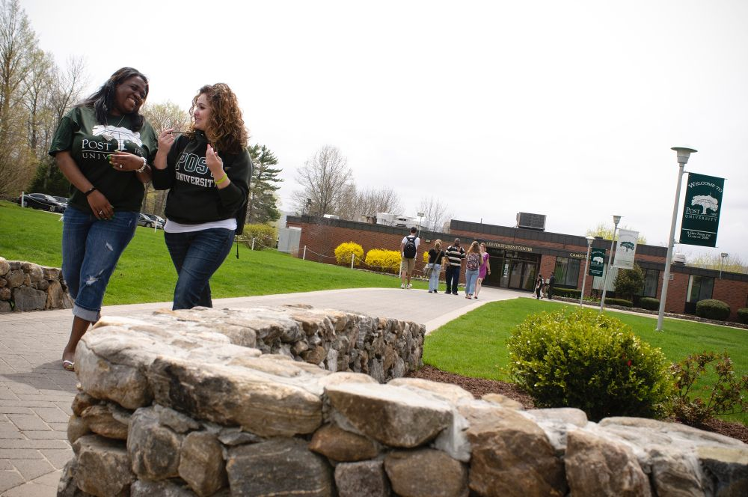
Future Vision of Education at Post University
Tracy Collamore
Post University

Slide 2
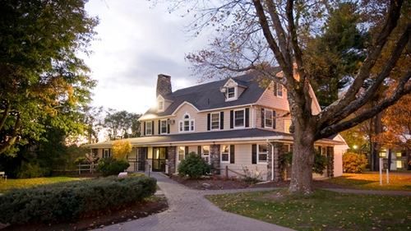
History: Past & Present @ Post University
An accredited, four year institution of higher learning located in Waterbury, CT.
Founded in 1890, has maintained its mission to “provide students with the knowledge, personal skills and experiences required to become leaders in their chosen careers.” (“About Post: Mission”, 2019)
Expanding online programs to include advanced degrees and professional certificates since 1990 as well as
Maintains a traditional campus for day students representing a diverse demographic in its student body. (“About Post”, 2019)

Slide 3
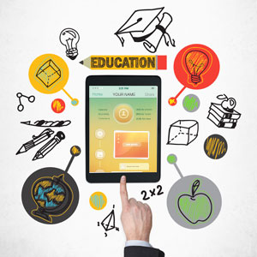
Technology @ Post University
Learning Analytics & Adaptive Learning
Technology caters to individuals’ needs, strengths, and weaknesses in education.
Designing methods of tracking student response rates and engagement online.
Includes recognizing basic emotions. (Durney, Milescu, Rughinis & Posea, 2015).
BYOD (Bring Your Own Device)
Devices offer the resources to research class content in real time.
BYOD is essential for STEM and prepares students for today’s technological advancements. (Berek, 2018)
Students have the ability to interact with global resources and trending technology in a way that cannot be accomplished otherwise.

Slide 4
Futuring Techniques: Pros and Cons
Scenarios
Scanning
Sound ideas for potential changes
Research past and current trends to plan for future
Respond proactively
Cannot predict the future
Requires experience
No “wishful thinking”
Research the experts and consider potential impacts
Summarized, organized
Chart implications and importance
Personal bias discredits information
May rely on other institution’s futuring strategies instead of creating their own

Slide 5
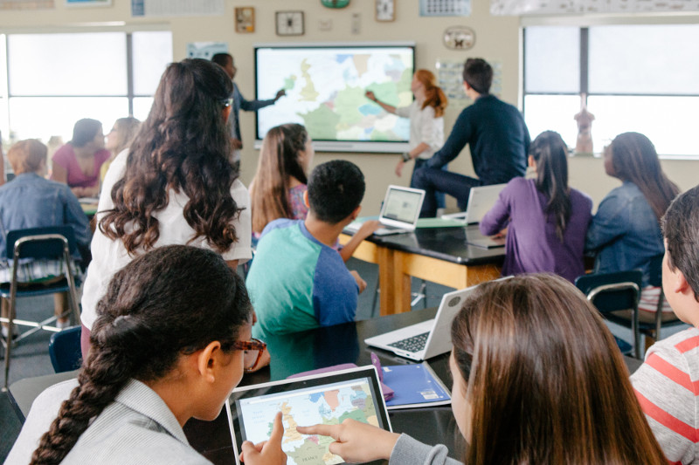
Scenarios & Scanning
Pros::
:Cons
Work together to develop sound future strategies
Cannot predict the future with 100% accuracy
Create plausible system to think proactively and meet the needs of the future before they arise
Results can be biased from personal opinion resulting in ineffective strategies
Especially necessary in education:
Futuring, when successful, uses past and present trends to create a future plan that will prepare students for their future.
Students will not be prepared for the future without sound strategies

Slide 6
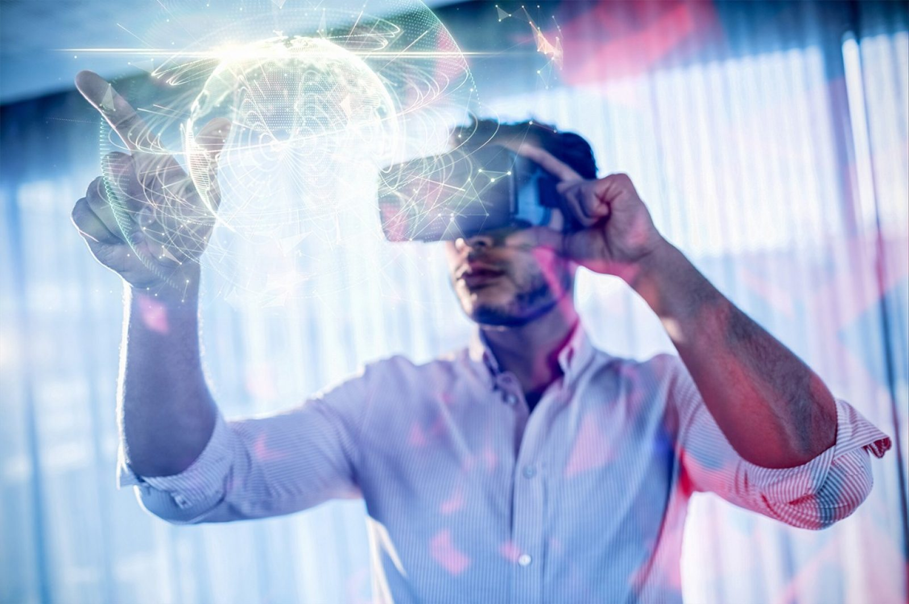
Technology Trends: Future of Education
Computer Learning
Virtual Reality
Online Learning
Current academic model: analytical learning.
“It is not simply about “how” you learn but what things you “know.” (Leer & Ratsa, 2013, p. 16)
Computer-based learning: customize education to each student.
Virtual reality: immersive learning with the ability to experience places, cultures, and past civilizations by being a virtual part of them.
Practice Latin, History and Art by virtually experiencing the Ancient Roman civilization.
Online college: provide students access to a quality education focusing on student-lead, technology-driven education.
Encourages independent thought, critical thinking skills, improves technological fluency, and creates graduates capable of entering the 21st-century workforce.

Slide 7

Ecomonic Trends: 21st Century Needs?
The economic structure of the 19th and 20th centuries were based on agriculture and industry (Glenn, 2014).
“Humanity clearly has the ideas and resources to address its global challenges, but it has not yet shown the leadership, policies, and management on the scale necessary” (Glenn, p. 15).
How to adapt to the future of education? How we can implement the changes necessary in terms of government policies, institutional (and teacher) readiness, and budgetary concerns?

Slide 8

Demographics: The Impact of Baby Boomers
From 1950-2011, the U.S. population doubled from 152.3 million to 308.7 million.
Baby Boomers are straining government resources, diverting money from public schools at a time when it’s needed most.
Students are leaning towards online education for the advances it provides.
Online students balance work, life, and education that couldn’t be done otherwise.

Slide 9

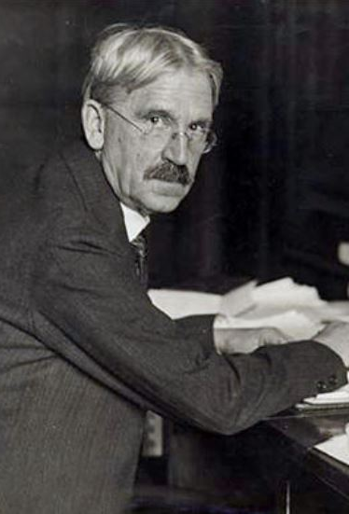
Historical Trend: Philosophy of Learning by John Dewey
The human mind is a clean slate and knowledge comes from experiences.
Dewey’s ideas impacted education not only with the theory of a social setting for education but also his ideas that students learn uniquely.
Educators must adapt to prepare youth for the ever-changing world by teaching future-relevant subjects and realizing that individuals learn differently and need individualized approaches to education

Slide 10
Vision/Plan: Integrate Technology
“You think of technology as a tool. We think of it as a foundation; it underlies everything we do.” (Prensky, 2013, p. 22).
Opportunities:
Challenges:
Independent, critical, creative thinking
Technology-fluent and adaptive to future innovations.
Core classes: more integrated.
Equal offerings with online and traditional campus classes.
Students: more confidant in meeting 21st century needs.
Up-front costs for new technology.
Preparing teachers to manage a successful student-led classroom.
Finding adequate academic sources on early stages of technology innovation.
Privacy & Augmented Reality.
Avoiding an “achievement gap”: provide all students with the technology they need.

Slide 11
Plan for Change
What we can do NOW:
BYOD
Access several online content sources
Initiate student-led learning
Foster independent, critical-thinking skills
Encourage interactive learning w/ peers
What we can do SOON:
Makerspaces
Provide innovative invention space
Student freedom to explore individual ideas
Offer trained specialists
Encourage inter-department collaborations
Our FUTURE:
Augmented Reality
Immersive virtual education
Experience past, present, future as an active participant
Integrate all classes into one, unified learning experience
Encourage interactive learning WITH THE WORLD!

Slide 12

Call for Action!
Encourage BYOD and device use in classrooms
Equip Classrooms with Student Devices
Earmark funds: provide devices over time rather all at once
Teacher-training:
Workshop series: Form a Committee of Leaders
Create opportunities for teachers to learn and experience blended classrooms
Engage educators in peer-to-peer learning opportunities
Encourage group discussions amongst educators on adapting teaching to meet the needs of the 21st century

Slide 13
References
About Post University. (n.d.). Retrieved March 13, 2019.
Berek, D. (2018). Bring Your Own Device (BYOD). Research Starters Education, 1-4.
Broadbooks, J. (2018). Call for Action: Cook prevailing wage requirement. Illinois Realtors. Retrieved April 20, 2019.
Dewey, J. (1916). Democracy and Education: An Introduction to the Philosophy of Education. New York: MacMillan.
Dunaey, M., Milescu, G., Rughins, R. & Posea, V. (2015). Expressio: Automatic Feedback for MOOC Teachers Based on Affective Computing. eLearning & Software for Education, (3), 43-48.
George, Sajan. (2013). The Future of Education: Sajan George at TEDxUNC. Retrieved March 20, 2019.
Glenn, J. (September 2014). Our global situation and prospects for the future. The Futurist, 48(5).
Gupta, J. (2019). 5 Ways Businesses are using Virtual Reality right now. QuyTech. Retrieved April 20, 2019.
Hong, D. (2017). Technology in Eduation: Changing the way kids learn. Lam Research. Retrieved April 20, 2019
John Dewey and the Ideal of Democracy (2019). Philosophy Talk. Retrieved April 20, 2019.

Slide 14
References (cont.)
Leer, R. & Ivanov, S. (2013). Rethinking the future of learning: The possibilities and limitations of technology in E\Education in the 21st Century. International Journal of Organizational Innovation, 5(4), 14-20.
Michael, L. (2017). 7 Things baby boomers have ruined for millennials. City Journal. Retrieved April 20, 2019.
Mietzner, D., Reger, G. (2005). Advantages and Disadvantages of Scenario Approaches for Strategic Foresight. Int. J. Technology Intelligence and Planning, 1(2) ,220-239.
Millett, S. (2006). Futuring and Visioning: Complimentary Approaches to Strategic Decision Making. Strategy and Leadership, 34(3), 43-50.
Post University Online Programs (2018). U.S. News and World Report. Retrieved April 20, 2019.
Roche: generations + works. (n.d.). Condencity Blogspot. Retrieved April 20, 2019.
Shrestha, L.B. & Heisler, E.J. (2011). The changing demographic profile of the United States. Washington D.C.: Congressional Research Service
Sobrero, P. (2004). The Steps for Futuring. Journal of Extension, 42(3), 12-16.
Toomey, E. (2018). Distraction or Encourages Interaction? Technology in the Classroom. NAEYE the Newspaper. Retrieved April 20, 2019.

